Slide 1
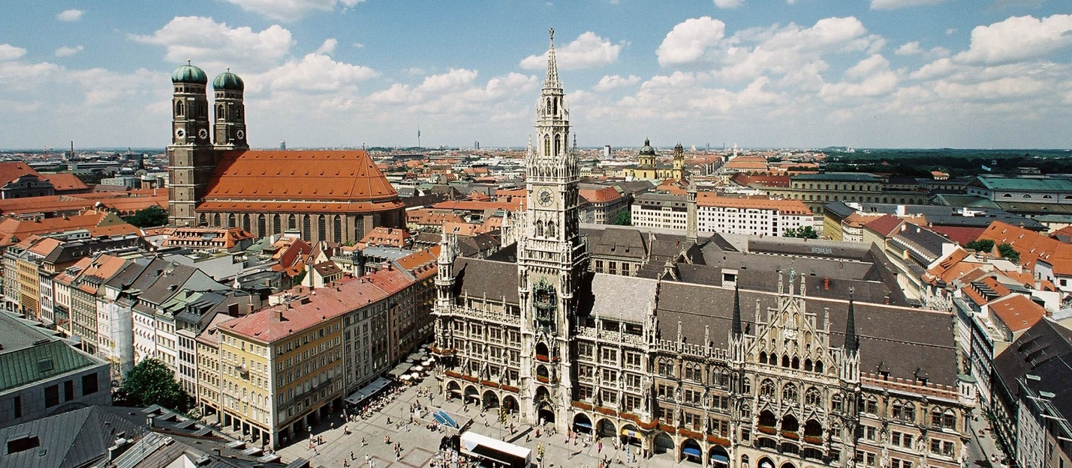
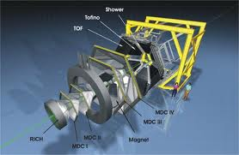
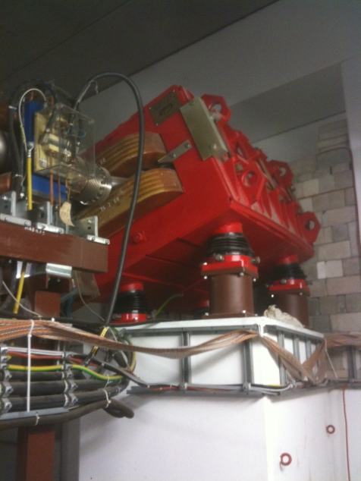

The HADES Π beam line: an update
T. Hennino (IPN Orsay)
XXVII HADES Collaboration Meeting
München, 5-7/2/2014
With E. Atomssa, W. König, B. Ramstein, P. Salabura, J. Biernat

Slide 2
Brief reminder of the problem
Find the ‘best’ tuning of the ‘beam line’ that fulfills
  Highest flux at the HADES target (33.465 m away from the production target)
  Best possible focus and achromaticity at the HADES target point
  Compact geometry to keep within detector and LH2 geometrical sizes
  Resolution on the individual pion momentum
    Identification of reaction through MM or IM cuts
    Energy scan
  Impact point resolution to eliminate background reactions induced in LH2 solid parts

Slide 3
The HADES beam line: horizontal view
HADES cave
In the old configuration
Production target
Q1
Q2
FOPI
D1
Q3
Q4
Det 1
Q5
Q6
D2

Slide 4
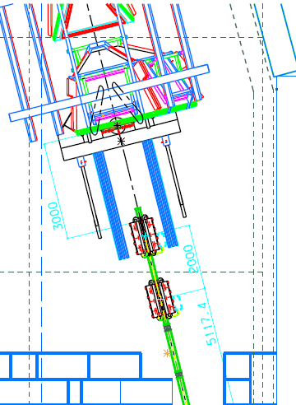
The HADES beam line: standard setting SET 6
Detector 2
Q8
H Foc
Q9
V Foc
Q7

Slide 5
Transmission versus step number
SET 6: FDF
Det 1
Dip 2
Acceptance normalised to the input conditions:
- 6 % < δ < + 6 %
- 10 mrad < θ < + 10 mrad
- 50 mrad < ϕ < + 50 mrad
Qua 7
HADES
Qua 2
Average transmission
18.5 %
Dip 1

Slide 6
x-y (in mm) at HADES_LH2 with |x|,|y|< 6 mm
Losses between Q9 and HADES target
-6%
-4%
Fraction left (in %)
1%
7%
14%
31%
z: log scale
-2%
0%
Global transmission
μ = 0.46 %
σ = 1.52 %
56%
95%
100%
100%
2%
4%
73%
42%
22%
13%
δ (%)
6%
(# of pions at HADES with |x|,|y| < 6 mm) / (# of pions after the last quadrupole) = 66 %
→ 34 % of the pions will interact with the non-LH2 target material
Overall pion transmission = (# of pions at HADES with |x|,|y| < 6 mm) / (# of pions emitted at the production target) = 18.6 %
10%

Slide 7
How to extract δ (and θ_{i}, ϕ_{i} and y_{i} )
H and V are strongly coupled + chromatic terms in vertical
2 equations ( one measured X position at detector 1, another one at detector 2) with 8 terms
Coupling to ϕ
HV coupling
Chromatic 2nd order V coupling
Chromatic 1st order
HV coupling
Chromatic 2nd order
Coupling to θ
1st order + 2nd order terms × 10
2 equations (one measured Y position at detector 1, another one at detector 2) with 7 terms
System of 4 non-linear equations with
4 unknown θ_{i ,} y_{i} , ϕ_{i} and δ ( x_{i} term ‘neglected’)
→ solved iteratively

Slide 8
π momentum resolution
At δ ≈ 1.5% (shift due to off focus detector1)
  σ_{p} scales with σ_{x}
  σ_{p} = 0.11%
  multiple scattering negligible
At large |δ|
  σ_{p} dominated by multiple scattering effects
  σ_{p} weakly sensitive to σ_{x}
  σ_{p} scales with 1/p
  Within ± 2σ_{trans} :
    σ_{p} < 0.2 %
p_{π}=0.65 GeV/c
σ_{x}=0.5 mm
± 2 σ transmissionband
p_{π}=1.3 GeV/c
σ_{x}=1.0 mm
p_{π}=1.3 GeV/c
σ_{x}=0.5 mm
Contributes weakly (1/3) to the
MM resolution in the reaction
π⁻ p → e⁺ e⁻ n
(HADES resolution dominated)
- - - no ms

Slide 9
X-vertex resolution at HADES target point
At δ ≈ 0%
no 2nd order chromatic terms
Effect of Coulomb scattering = 0.
→ resolution is ~ proportional to horizontal primary beam size σ_{x}
p_{π}=0.65 GeV/c
σ_{x}=0.5 mm
± 2 σ transmissionband
At large |δ|
Coulomb scattering dominant
resolution is almost independant on the horizontal primary beam size σ_{x}
Scales linearly with 1/p
p_{π}=1.3 GeV/c
σ_{x}=1.0 mm
  Within ± 2σ_{trans} : σ_{x} < 2 mm
p_{π}=1.3 GeV/c
σ_{x}=0.5 mm
Good selection of LH2 events

Slide 10
‘Measuring’ the 15 coefficients
Incident proton beam 4.3 GeV/c, pion production target off
Measuring the dispersive terms: T₁₆, T₃₆, T₁₆₆, T₃₆₆
  tune second part at δ = -4%, -2%, 0%, 2% and +4%
Measuring the <x/y|x/θ..> terms: T₁₁, T₁₂, T₃₂, T₁₁₆, T₁₂₆
  θ_{i} = [-8, 0, 8] mrad , x_{i} = [-2, 0, 2] mm
  δ = 0 and 2%
Measuring the <x/y|y/ϕ..> terms: T₁₄, T₃₃, T₃₄, T₁₄₆, T₃₃₆, T₃₄₆
  ϕ_{i} = [-7, 0, 7] mrad , y_{i} = [-1, 0, 1] mm
  δ = 0 and 2%
Index
numbering scheme
X
θ
Y
ϕ
−
δ
A few shifts (during daytime) with beam experts and pion tracker (HADES detectors turned off)

Slide 11
Measuring the dispersive terms
Minimize:
And extract horizontal and vertical dispersive coefficients T₁₆, T₁₆₆, T₃₆, T₃₆₆ and a possible offset X₀ (misalignment of magnet and/or detectors)
In total 12 parameters = 3(X_{O}, T₁₆, T₁₆₆) × 2(X and Y) × 2 (det1 and det2)
with 5 different settings of the HADES beam line
H plane
V plane

Slide 12
How to extract the term involving θ and ϕ
Use the same 4.3 GeV/c proton beam on the pion production target
Can we focus the beam at the production target with different x and θ for T_{1j} coefficients, resp. y and ϕ for T_{3j} coefficients
  Use the kickers (4 available) along the beam line
  Use position sensitive device
    Grid in X and Y (good position resolution ~0.2 mm)
    Scintillating detector at the π production target
      No calibration on x impact possible
      Calibration on y impact possible (step motor)
What is the precision that can be achieved
→ simulation

Slide 13
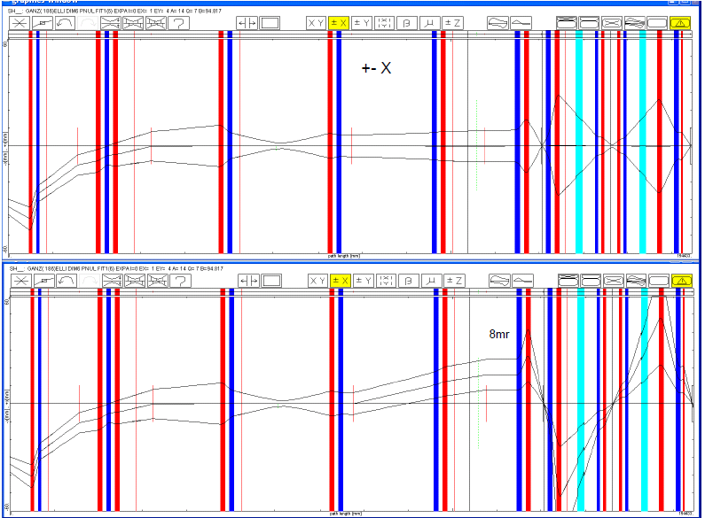
Tuning the beam with an θ angle offset
Standard tuning:
Beam on optical axis
Scint.
X-Y diagnostic box
Incident beam line
HADES π beam line
Kicked beam:
TH2KX1 and HADKX1
Incident angle at the pion production target = - 8 mrad
HADES X-Y detectors
HADES LH2 target
TH2KX1:
2 mrad kick
TH2KX1:
1 mrad kick

Slide 14
Determining the non-dispersive 1st order coefficients
Specific Simulation software
Inputs:
  Max Angle of incidence: Δθ = 8 mrad (or Δϕ = 7 )
  Max Width of angular divergence: δθ = 1 mrad (or δϕ = 4 mrad)
  Max Impact abscissa of beam at π production target: Δx = 0.2 cm (or Δy = 0.1 cm)
  Max Width of beam at π production target: δx = 0.05 cm (or δy = 0.05 cm)
  Number of recorded events (N=10⁶)
  Number of points (5 assumed)
Minimizing where :
  Δx_{i} and Δθ_{i} are central values of beam distributions at the π production target
  X^{det} are measured positions (include δθ and δx beam distributions around the central values )
  No sizeable geometrical abberations (T₁₂₂, T₁₂₄, T₃₄₄ , etc. very small) → no need to add more θ values
Outputs
  T_{ij} distributions
  12 parameters (6 in horizontal plane and 6 in vertical plane)
θ
X

Slide 15
Precision on coefficients
Test case (keeping Δx = 0.)
δT₁₂ / T₁₂ ≈ δx / ( N^{1/2} T₁₂ Δθ_{max} )/T₁₂ where N is the counting rate
→ << 1%
Precision of determination can turned down as low as reasonably possible
Systematic biases: taken into account later through a simulation
Beam H size
Beam angular offset

Slide 16
Results for detector 1 (δ=0)
N= 10⁶ events
T₁₁
T₁₂
T_{ij} | Theor. value | Fitted μ value | Fitted σ value | Relative precision on μ
T₁₁ | -1.782 | -1.777 | 2.533 | 0.15 %
T₁₂ | -4.835 10⁻² | -4.835 10⁻² | 6.32 10⁻³ | 0.01 %
T₃₃ | -18.6 | -18.58 | 46.4 | 0.25 %
T₃₄ | -3.84 10⁻³ | -3.77 10⁻³ | 6.6 10⁻² | 1.7 %
T₃₃
T₃₄
δ_{μ} = σ / (N)^{1/2}

Slide 17
Results for detector 2 (δ=0)
N= 10⁶ events
T_{ij} | Theor. value | Fitted μ value | Fitted σ value | Relative precision on μ
T₁₁ | -0.924 | -0.909 | 12.0 | 1.3 %
T₁₂ | -0.477 | -0.477 | 0.03 | < 0.01 %
T₃₃ | -69.9 | -70.0 | 245 | 0.35 %
T₃₄ | -0.8523 | -0.8519 | 0.35 | 0.04 %

Slide 18
Comments on the requested beam initial conditions
Δx, Δθ
  No real measuring device at the π production target → 2 options
  Only MIRKO-based estimates from kicker currents in TH2KX1 and HADKX1 and measured position on 2 ‘detectors’ (grid and scintillator)
  Beam always centered on the scintillator (access to T₁₂ only )
Δy, Δϕ
  Scintillator step motor gives access to y position; precision?
  Comparison with MIRKO calculations will help controlling the H plane
Detectors
KIckers

Slide 19
Extracting 2nd order coefficients:
T₁₁₆, T₁₂₆, T₁₄₆, T₃₃₆, T₃₄₆
Tune the HADES beam line to δ=-2% and minimize the quantity
where
→ determination of T’₁₁ and T’₁₂ and extraction of T₁₁₆ and T₁₂₆ by
effect of 2nd order contribution; =0.5- 1.5 cm
→ extraction of 10 parameters (5 coeff × 2 detectors)
T₁₆ and T₁₆₆ are known with high precision

Slide 20
Systematic error propagation (I)
Question: Can uncontrolled systematic offsets lead to a wrong determination of coeeficients and then to an uncorrect momentum determination
  When extracting coefficients, we may have systematic biases when tuning the beam for different incident angle and position
  we do not have full localization capabilities in a magnet-free region
    δ: most likely very low (<< 1%) (localization of beam irrelevant)
    θ: 1 mrad over 8 mrad (< 20%)
    ϕ: 1 mrad over 8 mrad (< 20%)
    x: < 0.2 mm (<50% of image size)
    y: < 0.2 mm (<50% of image size)
  Systematic study for all coefficients (8 in H plane and 7 in V plane) at the 2 detector locations
    1st order dispersion term T₁₆ and T₃₆ changed by 10%
    1st order magnification terms (T₁₁ and T₃₃) changed by 50%
    All other terms changed by 20%

Slide 21
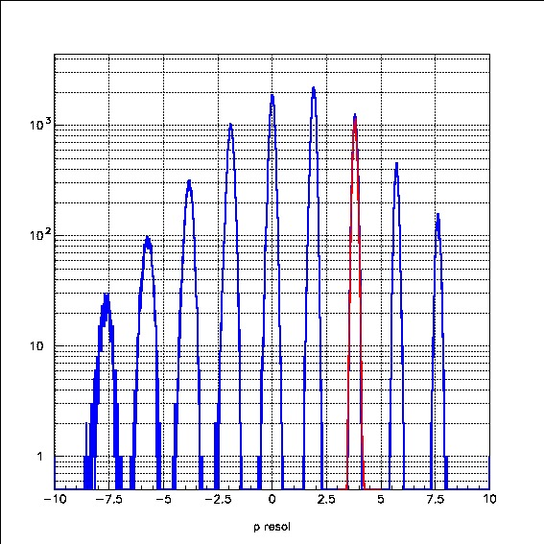
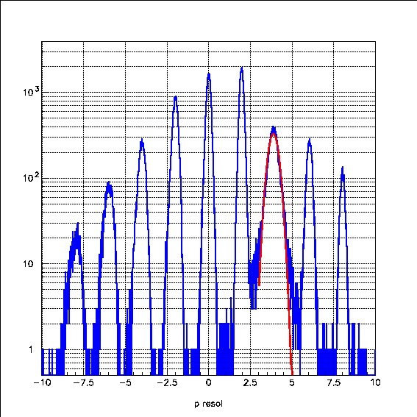
Systematic error propagation (II)
No noticeable effect seen
  absolute shift on pion momentum smaller than 0.01%
  Resolution unchanged
2 exceptions
  T₁₆: changing its value by 10% shifts the extracted δ value by 0.1% at δ=2% (effect comparable to the resolution)
  T₃₃: changing its value by 50% influences the resolution, but only at a given δ value (compensation effect between the T₃₃ and T₃₄₆ terms)
µ=1.91% (2%)
μ=1.94 % (2%)
σ=0.23% (0.1%)
µ=3.8% (4%)
µ=-3.8% (-4%)
Momentum offset δ (%)
Momentum offset δ (%)

Slide 22
Beam time estimate
Proton beam
  3.5 GeV
  Low intensity (< 10⁴ pps to fit within the DAQ capabilities)
Dispersive terms: T₁₆, T₃₆, T₁₆₆, T₃₆₆, X₀, Y₀
5 values of δ → 4 hours → 12 parameters (6 per detector)
Horizontal coupling terms: T₁₁, T₁₂, T₃₂, T₁₁₆, T₁₂₆
10 measurements = 5 in (x,θ) × 2 in δ ◊ 6 hours
10 parameters
vertical coupling terms: T₁₄, T₃₃, T₃₄, T₁₄₆, T₃₃₆, T₃₄₆
→ 10 measurements = 5 in (y,ϕ) × 2 in δ ◊ 6 hours
12 parameters
TOTAL of 2 shifts for measuring 34 parameters

Slide 23
Conclusion and outlook
Control of the calculated transport coefficients possible
Errors on δ induced by systematic errors very small or easily handable
Importance of measuring the offset parameters (absolute calibration of p_{cent})
To do
  Better treatment of multiple scattering effects ; detector 1 off the focus → result in 2 weeks
  Prepare the programs for fitting during the may beamtime

Slide 24
Spare slides
Individual contributions in the X plane
Individual contributions in the Y plane
X-Y occupancy plots
Table of coefficients
The system of 4 equations

Slide 25
Individual contributions in X
T₁₆
Index
numbering scheme
X
θ
Y
ϕ
−
δ
T₁₂
T₁₂₆
Detector 1
resolution
( = 0.8 mm)
T₁₁
T₁₄₆
T₁₆₆
T₁₄
T₁₁₆
T₁₂₂
T₁₂₄
T₁₃₆
Contibution (mm)
T₁₃
T₁₁₂
T₁₁₄
T₁₃₄
T₁₁₁
T₁₂₃
T₁₃₃
T₁₄₄
T₁₁₃
Only 8 terms contribute significantly : i.e. > 0.5 × detector resolution)
Detector 2 resolution
( = 0.8 mm)
Contibution (mm)

Slide 26
Individual contributions in Y
T₃₄₆
T₃₆
T₃₂₆
Detector 1 resolution
( = 0.8 mm)
T₃₃
T₃₂
T₃₃₆
T₃₆₆
T₃₁₆
T₃₄
T₃₂₂
T₃₁₂
Contibution (mm)
T₃₃₄
T₃₁
T₃₁₄
T₃₂₄
T₃₂₃
T₃₄₄
T₃₁₁
T₃₃₃
Only 7 terms contribute significantly : i.e. > 0.5 × detector resolution)
T₃₁₃
Detector 2 resolution
( = 0.8 mm)
Contibution (mm)

Slide 27
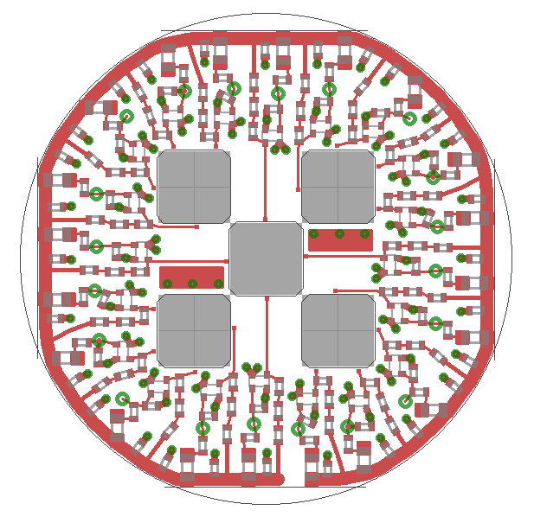
Space occupancy at detectors
condition at Q9
|x| , |y| < 6 cm
Condition at HADES:
|x| , |y| < 6 mm
Good events are well inside :
Silicon Detector 1 and Detector 2
LH2 entrance window
Some good events cut (< 10%) by size of diamond detector (15*15 mm²)
Light yellow zones correspond to the detector size
Entrance window of LH2 is 1 m ahead of LH2 target
Diamond detector is 0.4 m ahead of LH2 target
Try to move as close as possible to LH2 target

Slide 28
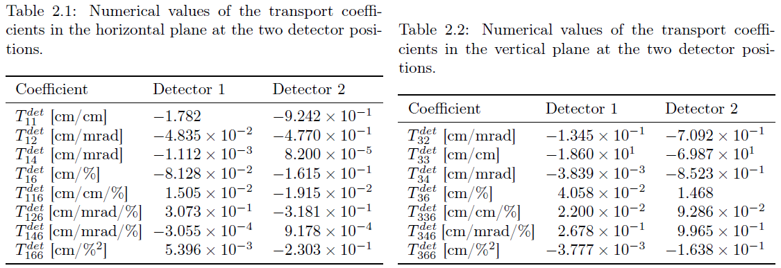
Values of the important coefficients
10⁻²
10⁻²
10⁻¹
10⁻²
10⁻²
10⁻¹
10⁻¹
10⁻¹
10⁻²
10⁻²
10⁻¹
10⁻¹
10⁻²
10⁻²
10⁻²
10⁻²
Several values have been corrected
(orders of magnitude !?

Slide 29
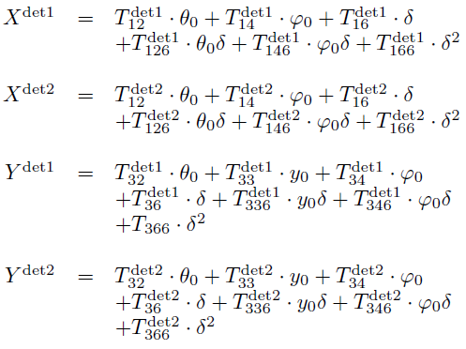
The 4 equations

