Slide 1
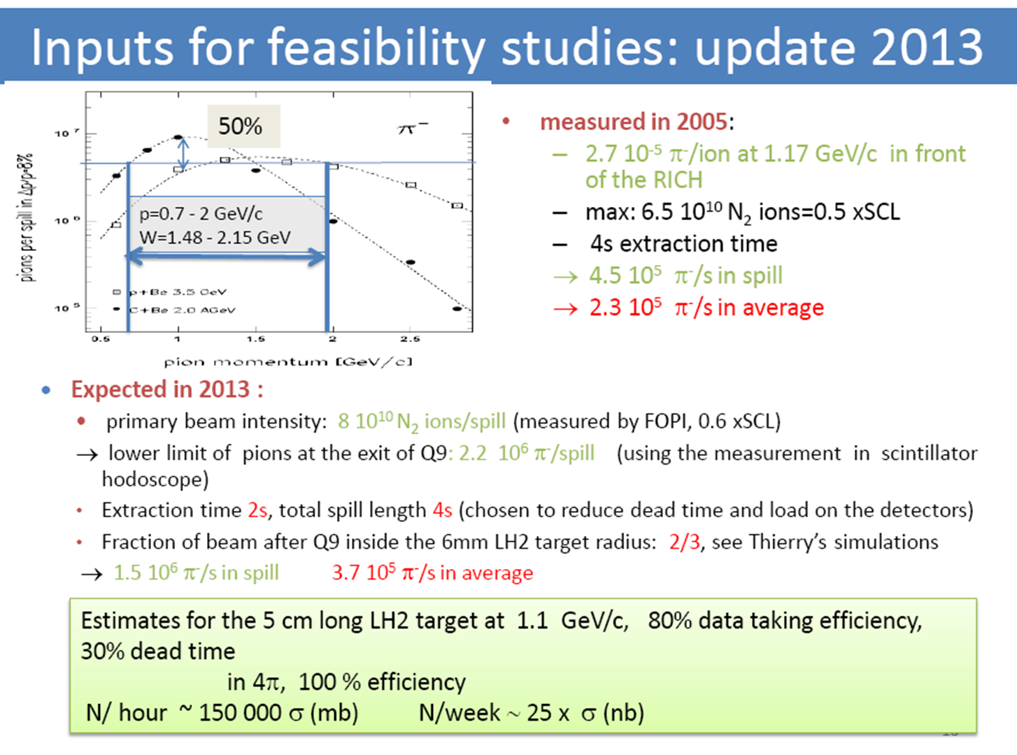

Slide 2
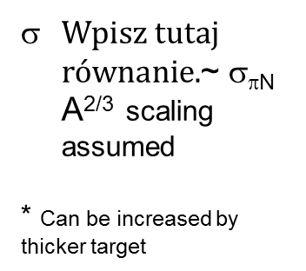
Count rate estimates from TDR
Assuming beam intenisties from previous slide and acc *rec from SIM
I=3.7e5 pion/s * 0.5 (data taking) *d *ρ * 6.02e23/A *(3600*24hours) * σ
 | LH2 case [counts/24h] p [GeV/c] beam momentum | Solid targey (tungsten 3*2.4 mm) [counts/24h] p [GeV/c] beam momentum
Dilepton yield M>0.3 GeV („Manley-transport model” scenario)-ρ contribution | p=0.66 ~50 P=1.03 ~30 | ~ 350 ~ 210
Dilepton yield M>0.3 GeV (Bonn_Gatchina)- ρ contribut. | p=0.66 ~ 7 * similar to Soyer/Lutz) p= 1.03 ~12 | ~ 50 ~ 86
Two-pions (π+π- ) | p=1.03 ~3e6
Σ⁻ K⁺ | p=1.03 ~96 000
Λ K⁰ | p=1.03 ~26 000
Σ⁻ K⁺ | p=1.03 ~20 000
~ σ_{πN} A^{2/3} scaling assumed
* Can be increased by thicker target
See slide 16 for strangeness on nucleus production

Slide 3
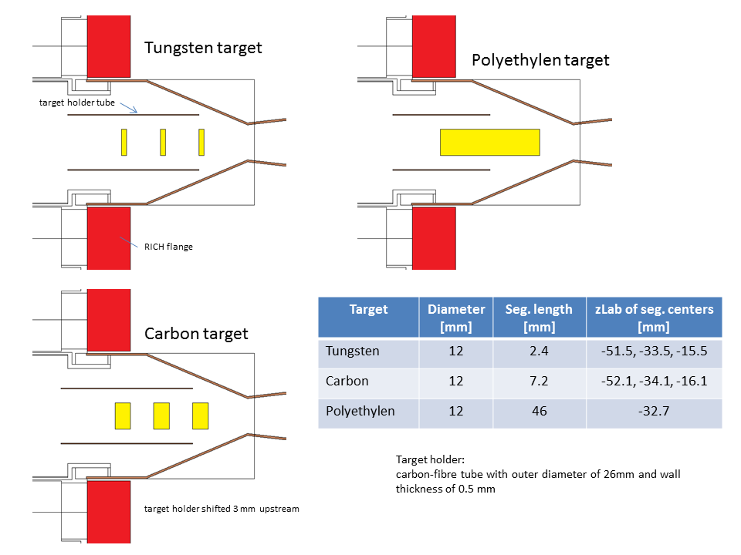
Targets
July 2014

Slide 4
Polyethylene as proton target for exclusive channels –
Proof of principle based on experimental data

Slide 5
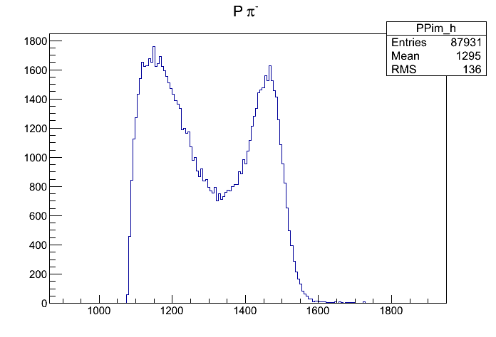
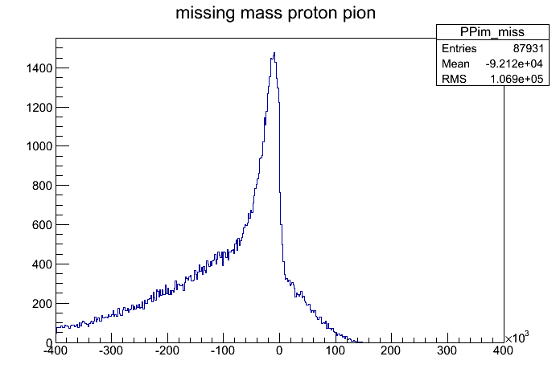
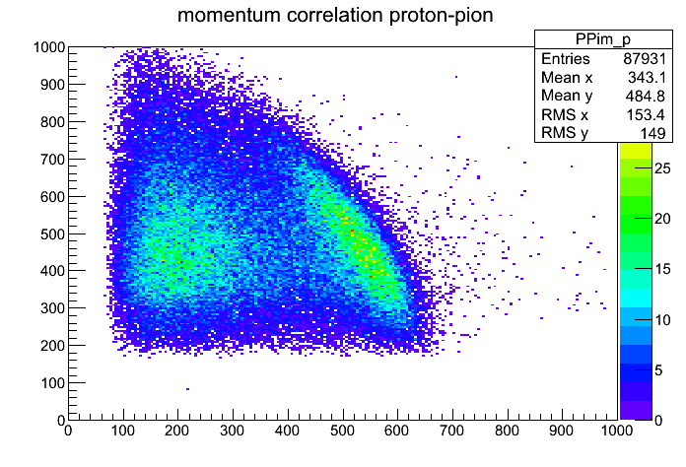
Carbon: Pion-proton events (2.1 MLN events analysed)
Pion-proton invariant mass
Squared !
Proton momentum
Pion momentum
Quasi-elastic scattering
Quasi-elastic scattering on bound proton (Elastic scattering ideally should have
Total CMS energy of 1498 MeV and missing mass zero )
Particle identification on mass spectrum

Slide 6
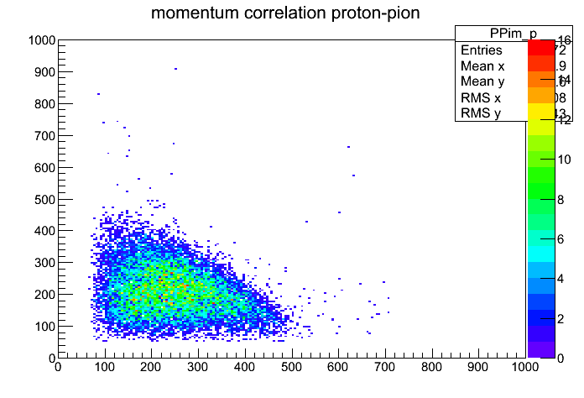
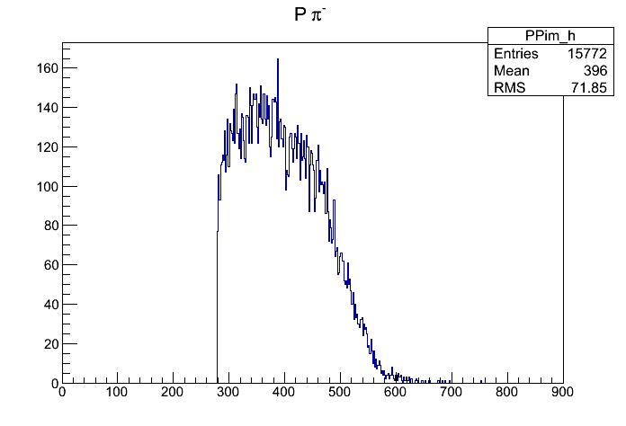
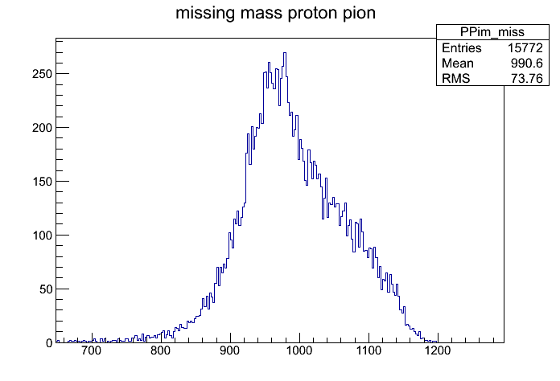
Carbon : π ⁺ π ⁻ events (2.1 MLN events analysed)
2pion invariant mass
2pion missing mass
di-pion events from Carbon target (no clear peak at missing neutron mass visible- expected for pion-proton reaction)

Slide 7
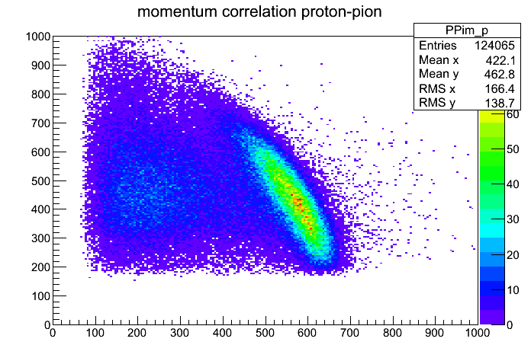
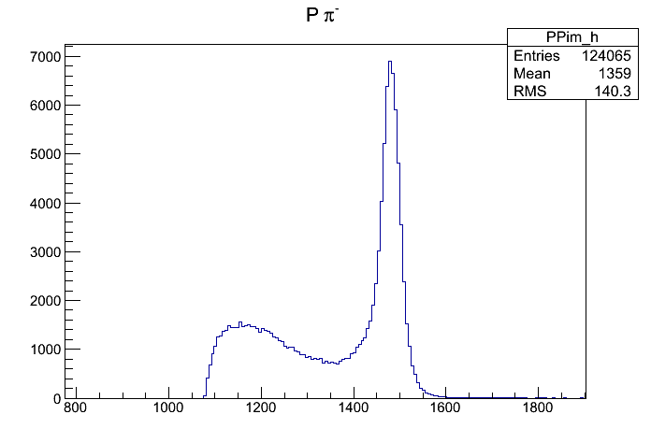
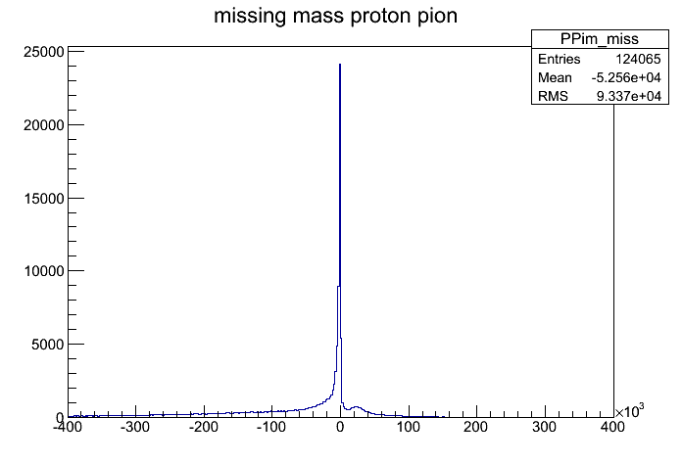
PolyEthylene: Pion-proton events (also ~2.1 MLN events)
Proton pion inv. mass
Proton pion miss. mass squared
very clear signal from proton-pion elastic scattering
~ 40% more (total) yield as compared to carbon target
Background can be almost completely isolated by cuts on inv. Mass & missing. Mass (see corresponding plots on slide 1)

Slide 8
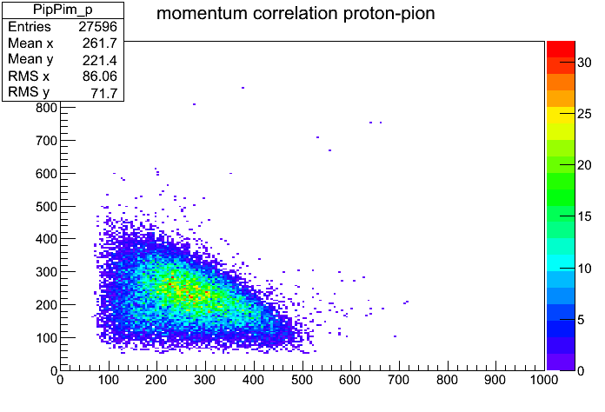
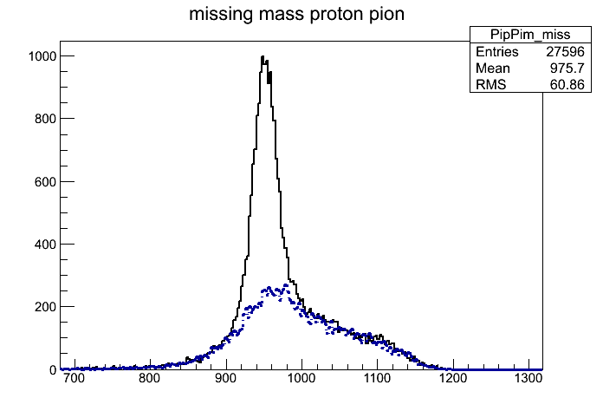
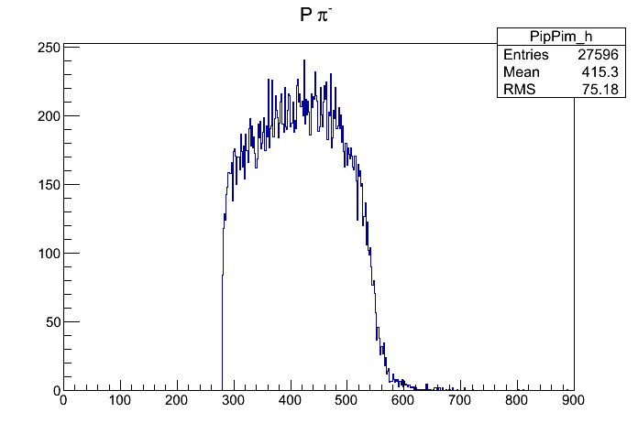
PolyEthylene: π ⁺ π ⁻ events (also ~2.1 MLN events)
di-pion inv. mass
Di-pion missing mass
very clear signal from π- p -> π- π+ n reaction (missing of neutron)
~ 100% more (total) yield as compared to carbon target
Background can be reduced by cut on missing. mass (dashed histograms shows resp.missing mass from carbon run (slide2) normalized to the number of collected events ~35% in window around missing neutron mass) -
resolution can be improved by pion momentum reconstruction, detector calibration(?)

Slide 9
Dileptons from PE (100 MLN -2 shifts)
1.7 GeV/c
0.7 GeV/c
S/CB ~2

Slide 10
Targets for August (5 or 7 segments)- W.I. Koenig
Conversion contributions:

Slide 11
Update on e+e- count estimate based on in-beam data
Collected number of events with PT1 triggers (0.7 GeV/c) 100 MLN/17 hours (2 shifts)->number of pions on START ~280k/spill (0.69 GeV/c corresponds exactly to η production threshold-which is what we had taking into account energy loss of pions in in-beam detectors)
Density of protons in 5cm long PE 4*10²³ /cm² , density of carbon ~ 2*10²³ /cm²
Cross section for dieleptons M>0.3 GeV - 480 nb. Reconstruction eff. (including RICH) 0.4 –from full scale simulations
Expected number of detected di-leptons from proton for 100 MLN collected PT1 events:
N= 1.e8 x 4.0e23 x 1.e-24(barn->cm² ) x 480e-9 (nb) x 0.4(only reconstruction eff. matters for triggered events!) = 8 !
if production on carbon scale like A^{2/3} we can expect factor 2.5 more dileptons from carbon ~ 16
Measured : 13 (slide 9)
Possible gain factors:
Beam intensity (factor 2?)
for exclusive e+e- production use kinematic constraints (missing mass) –no RICH PID necessary (need to be studied)?- factor 2-3 gain

Slide 12
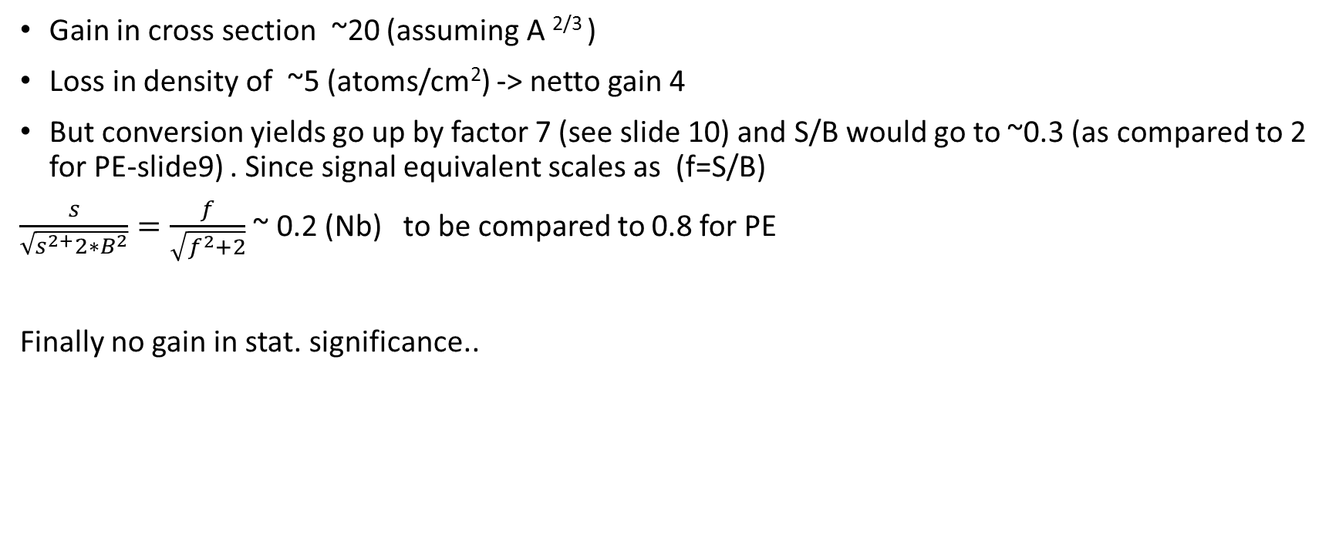
Heavier target: Nb vs p in PE
Gain in cross section ~20 (assuming A ^{2/3} )
Loss in density of ~5 (atoms/cm²) -> netto gain 4
But conversion yields go up by factor 7 (see slide 10) and S/B would go to ~0.3 (as compared to 2 for PE-slide9) . Since signal equivalent scales as (f=S/B)
$\frac{s}{\sqrt{s^{2+}2∗B^{2}}}=\frac{f}{\sqrt{f^{2}+2}}$ ~ 0.2 (Nb) to be compared to 0.8 for PE
Finally no gain in stat. significance..

Slide 13
Update on π⁺π⁻ count estimate based on in-beam data
Collected numer of events with PT1 triggers (0.69 GeV/c) 100 MLN/17 hours (2 shifts)->number of pions on START ~280k/spill
Density of protons in 5cm long PE 4*10²³ /cm²
18k d-pions (within neutron missing mass peak) measured per 2 MLN collected events -> 900 k per 2 shifts
For PWA resonance analysis we need double differential distributions : assume 14 bins in both pion-nucleon and 14 in cos(ϑ_{cm} ) (~2700 bins) , 5% statistical error request around 1 MLN of di-pion events.
We need also a minimum energy scan (4) points around central energy point (0.69 GeV) with 30 MeV step – in total 8 shifts are needed
These shifts can by of course included into e+e- statistics (+- 60 MeV variation in momentum corresponds to change in total CMS of 1.456 to 1.533 MeV)

