Slide 1
One,Two pion channels from PE target August 2014 (~10 hours of beam)
50 MLN events (1.2 shift)
Day 232/233
Piotr & Witek

Slide 2
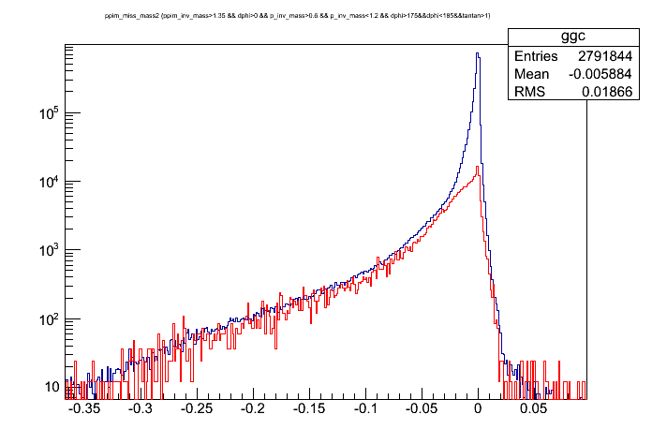
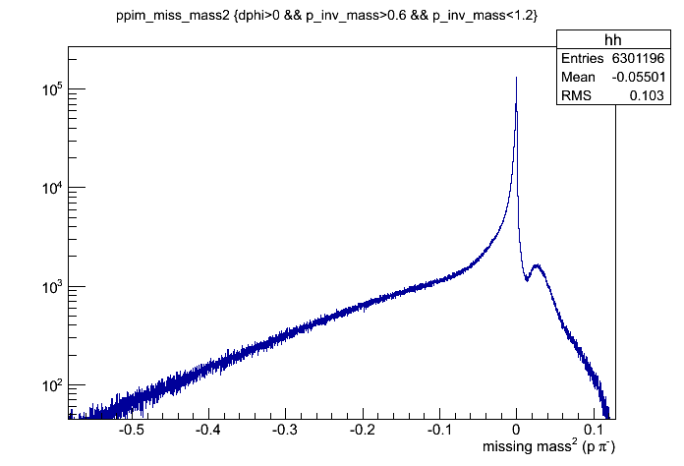
Pπ⁻ events with PID
Elastic events
Pπ-π⁰
Elastic events selected by condition on azimuthal and polar angle correlation (see next slide)
Red line – background from Carbon scaled from 2MLN events collected on carbon target in July

Slide 3
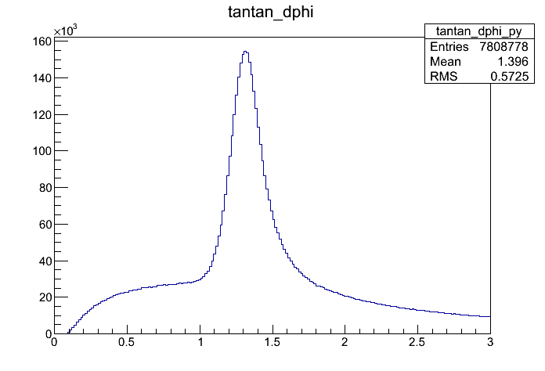
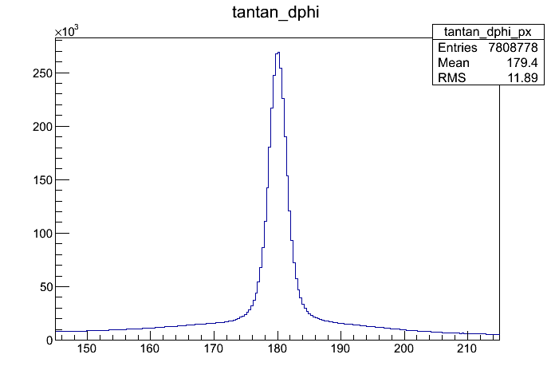
Pπ⁻ elastic events
tan ϑ₁ * tan ϑ₂ distribution
Remark ; can be used to determine pion beam momentum or alternatively to check pion momentum reconstruction with Tracker
Width depends on pion momentum !
Cooplanarity of two tracks

Slide 4
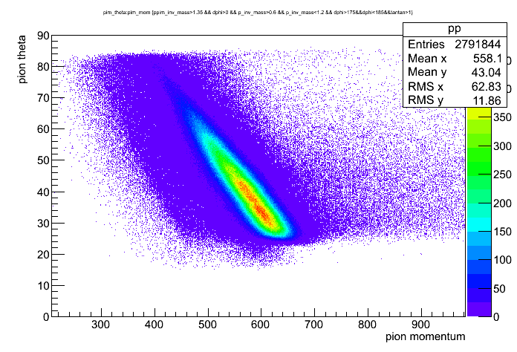
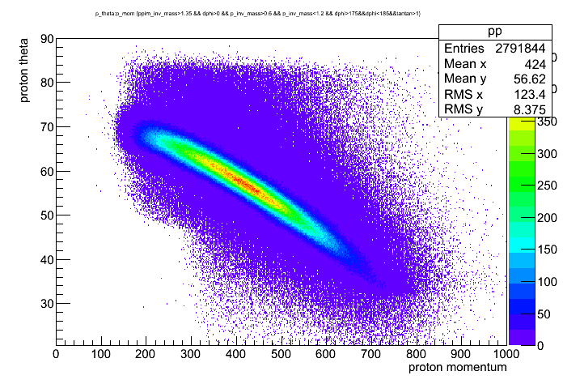
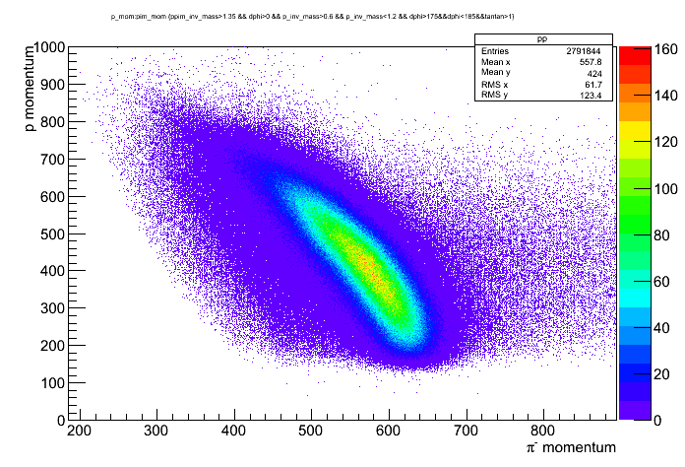
Pπ⁻ elastic events : selected via angular correlations
Pion – proton correlations
~ 2.7 MLN elastic events

Slide 5
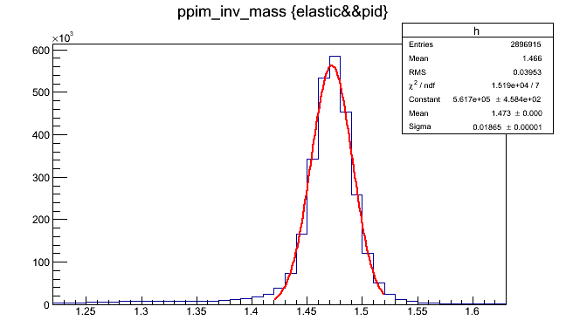
TOTAL CMS of elastic events
Pπ- inv. mass
~16 MeV below nominal CMS for 0.69 GeV/c pions
1.2% resolution from HADES reconstruction AND spread of pion incoming momentum

Slide 6
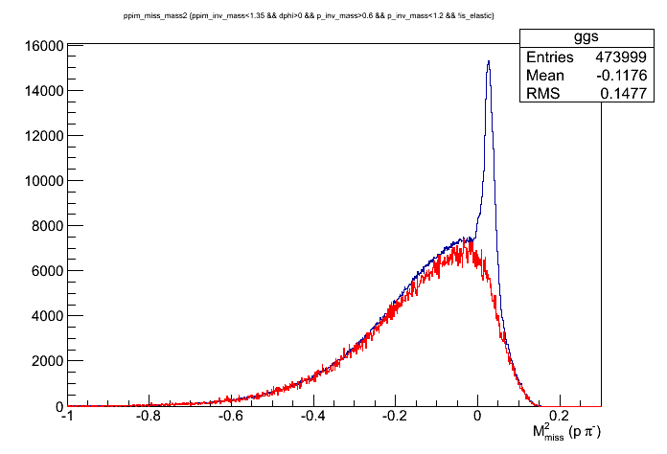
P π⁻ π⁰ elastic events: selected vie veto on elastic
0.33 MLN π⁻ π⁰ events (after background subtraction)
background (red) taken from carbon run in July (not completely perfect becuse of slight difference in time calibration- to be improved). Nevertheless, fits quite good

Slide 7
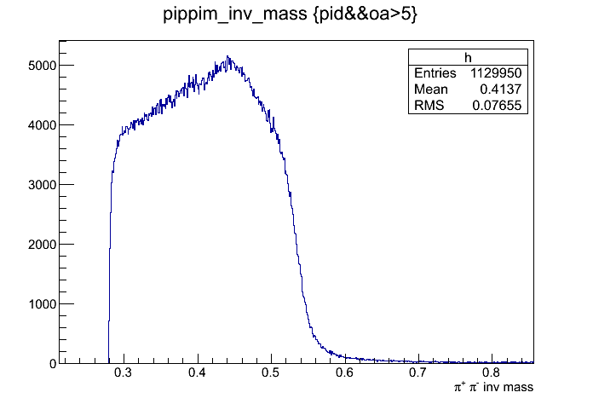
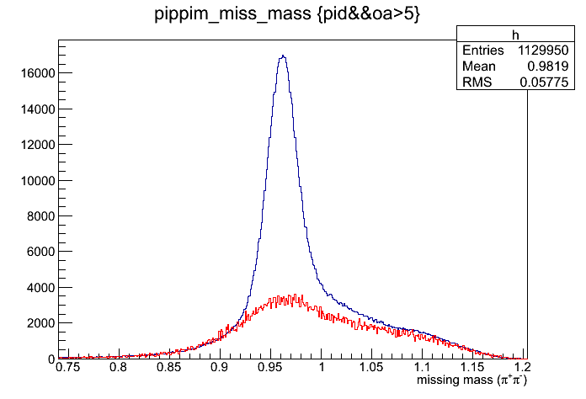
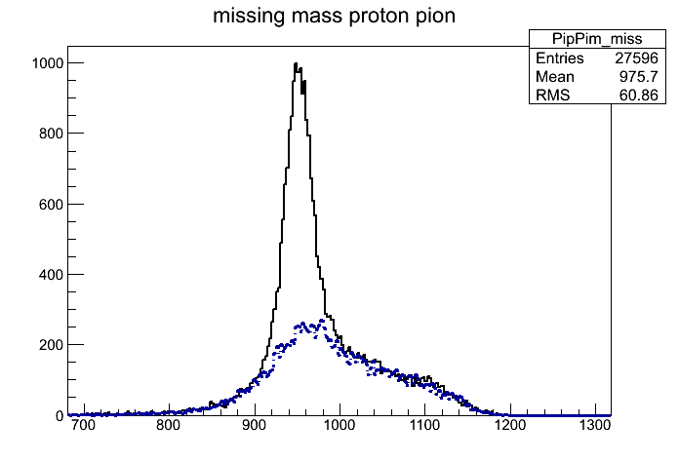
n π⁻ π⁺ selected with PID
Agust data and Background from July (carbon) not quite yet perfect for August data (time calibration affects PID cuts..)
For comparison: right same but both data samples from July with same time calibration and PID cuts

Slide 8
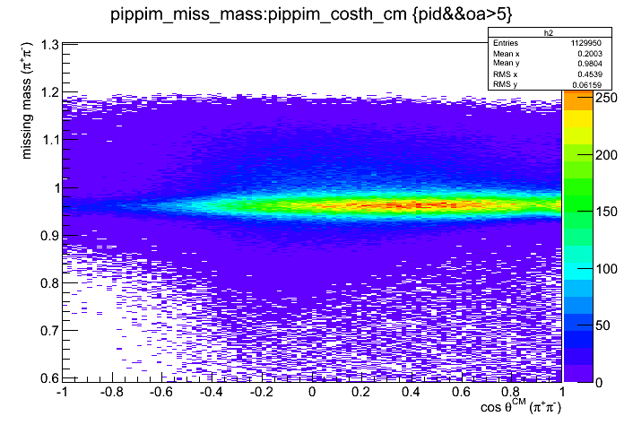
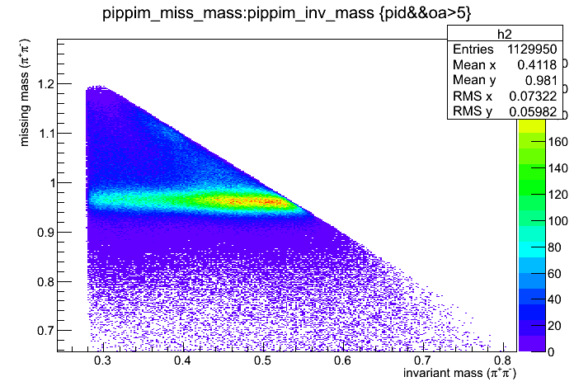
n π⁻ π⁺ selected with PID & missing mass cut
0.56 MLN 2 pion events after background subtraction from 52 MLN events- as expected from JULY 1 MLN needs 100 MLN (2 shifts)
background not easy to subtract from PE data alone, would be much easier to have dedicated run with carbon target for background sunbtraction

