Slide 1
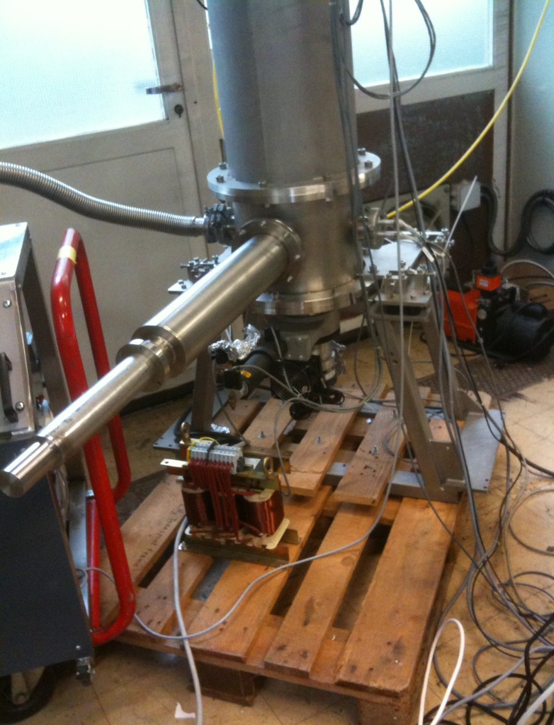
Tests of the LH2 target at GSI 2nd-4th april 2014
The LH2 target
T. Hennino, C. Commeaux (IPN Orsay)
T. Heinz, E. Schwab (GSI)

Slide 2
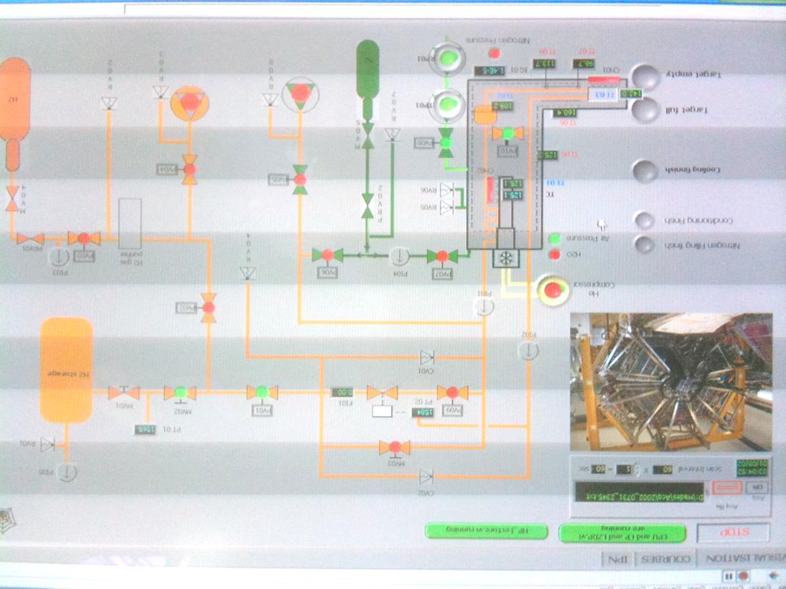
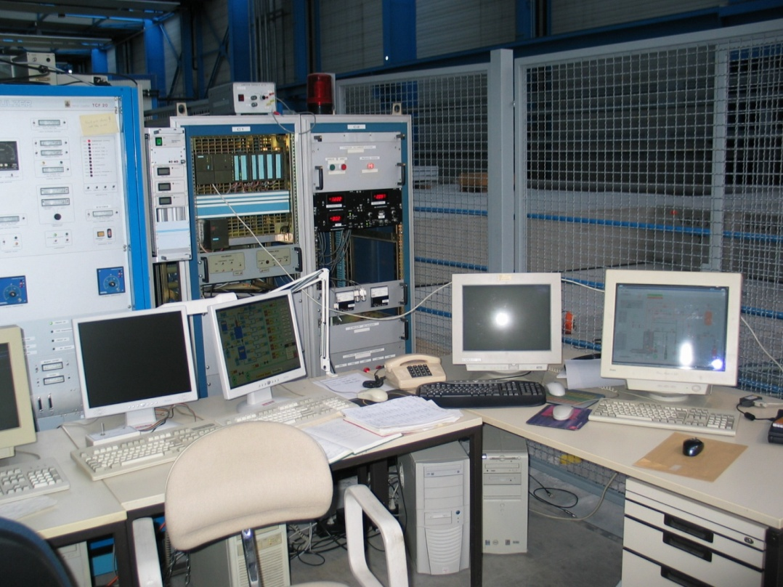
Aim of the test
Restart the target in the GSI environment
Preparation actions
Target transported from Orsay by T. Heinz in march
Reinstalled on the HADES beam line with all connections (T.Heinz + E. Schwab)

Slide 3
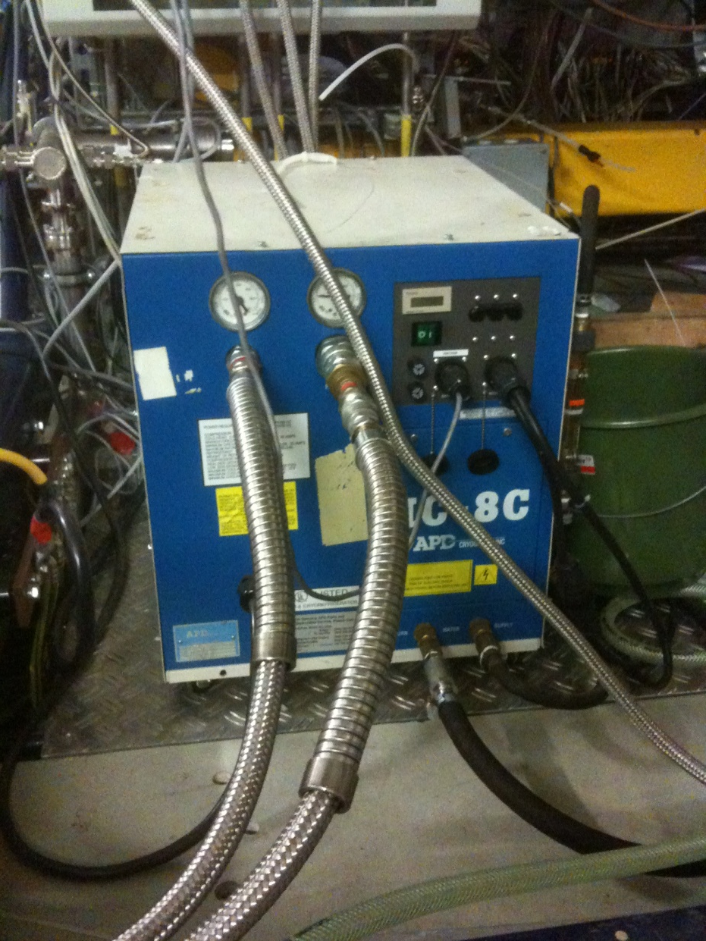
Problems encountered
Low ⁴He pressure in the compressor (200 psi instead of 270-300) → compressor refill (bring specific pipe/connector to GSI)
Water leak on the compressor cooling circuit → repair (GSI)
Missing control box of pressure sensor PG02 → exchange with PG01 (directly powered)
Box found in cabinet (to be repaired (T. Heinz) or replaced)
The compressor at GSI

Slide 4
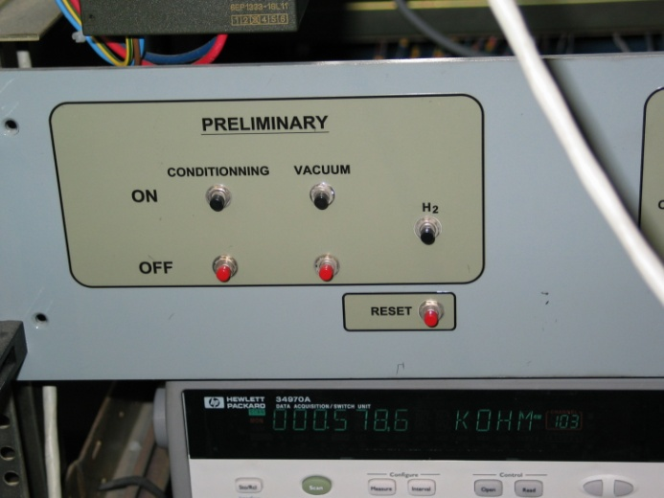
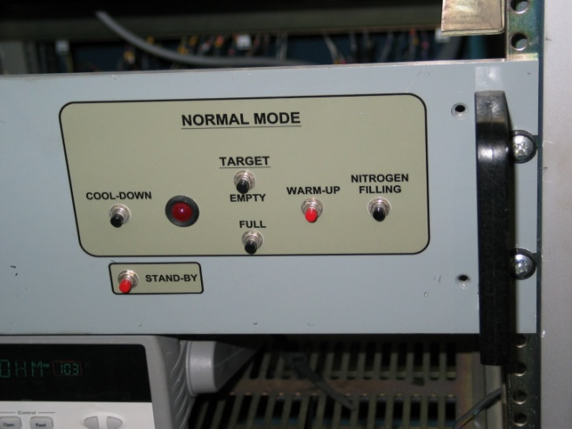
Logbook of actions and results
2/4/2014 10:45 start vacuum pumps
2/4/2014 11:15 conditionning (purge)
2/4/2014 14:30 start of cooling down
2/4/2014 20:00 20°K reached in condensor
2/4/2014 23:55 29°K reached at the target
3/4/2014 0:30 compressor stopped for the night
3/4/2014 6:15 restart of compressor
3/4/2014 10:00 cooling finished: target full
3/4/2014 several cycles empty/full target over more than a day → OK
4/4/2014 11:45 Target stopped

Slide 5
Further actions
Restart the target week 7-11 april (Torsten alone)
Target removal from beam line and preparation of test run with proton
Saving the computer disk (M. Traxler on Monday 7th)
Update the note « working procedure of the HADES LH2/LD2 target »
New visit at GSI in may (week 20 or 21)

