Slide 1
Background from pion beam interactions with LH2 pipes
Only 34% of all pions make hit in START !
(see Jacek presentation from last meeting)

Slide 2
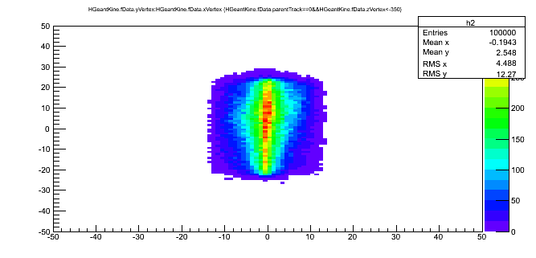
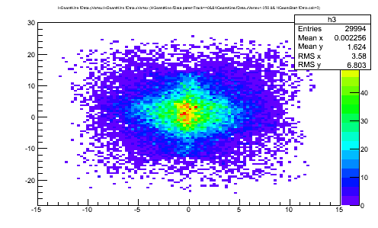
Distribution of Pions at emission plane located -1.3 m downstream
Acceptance of beam line selects pions with D/p
σ = 1.8%
Narrow in x and rather broad in Y with slight assymetry up-down
Primary Pions which made START hit

Slide 3
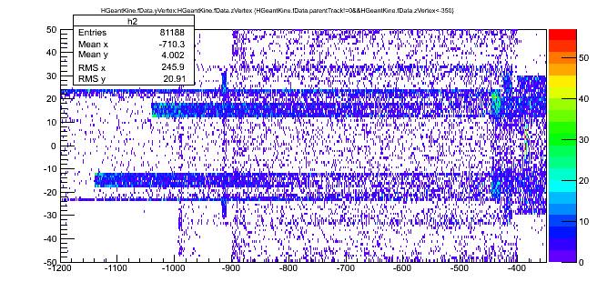
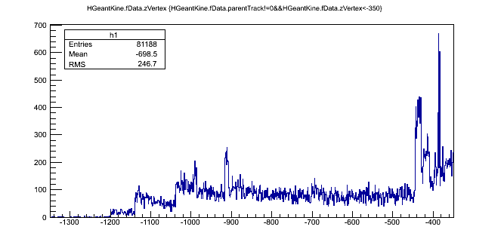
Vertex of secondary particle production (Y,Z)
Z vs Y distribution:
Pions (100k) emitted from -1.3 m; 80k secondaries
START detector located at -0.38 m (-380 mm )

Slide 4
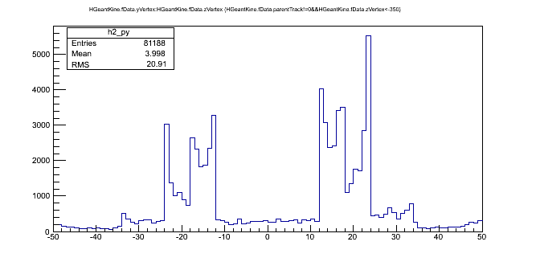
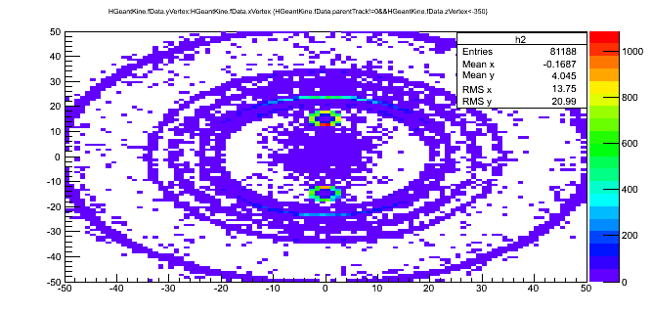
Vertex of secondary particle production (X,Y)
Y distribution:
Pipes with LH2 visible inside 20 mm diameter
-22,22 mm – tube
X vs Y distribution:
LH2 pipes and tube are clearly visible

Slide 5
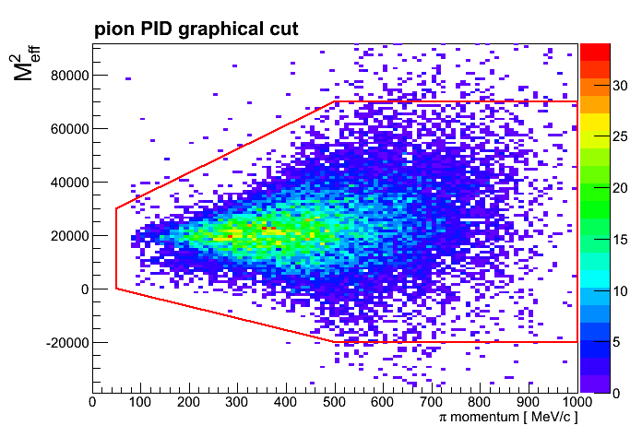
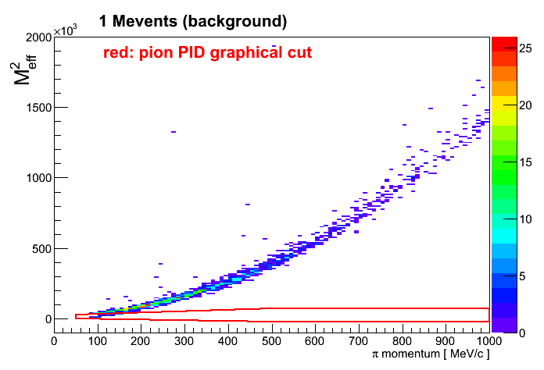
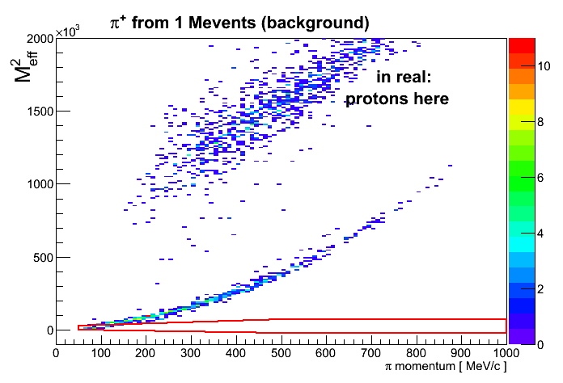
Benchmark channel π⁻p→ρn→π⁺ π⁻ n
GRAPHICAL pion PID CUT

Slide 6
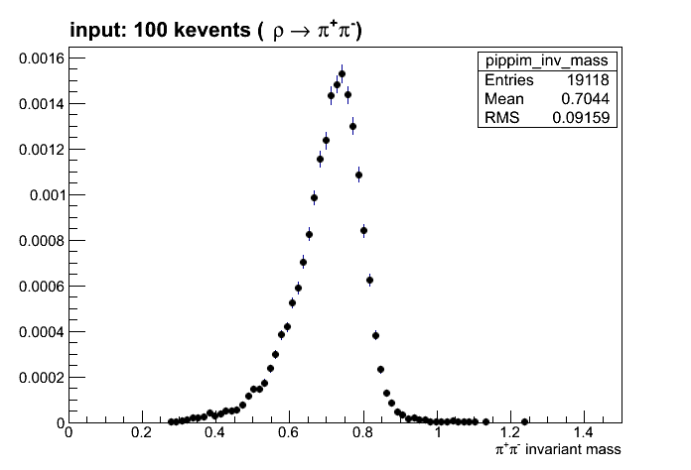
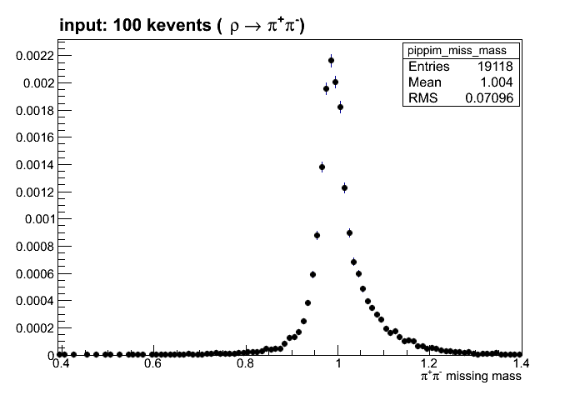
Benchmark channel π⁻p→ρn→π⁺ π⁻ n
About 19 kevents reconstructed from 100 kevents

Slide 7
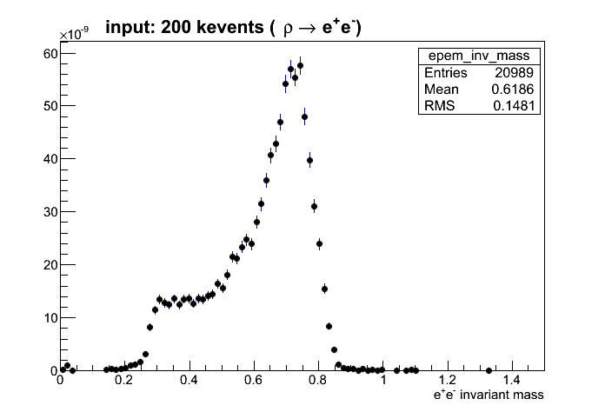
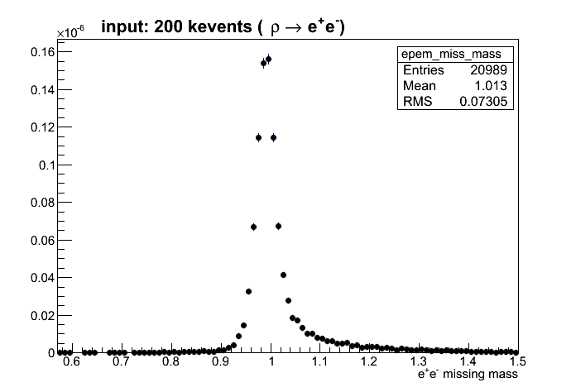
Dilepton channel π⁻p→ρn→e⁺e⁻ n
About 21 kevents reconstructed from 200 kevents

Slide 8
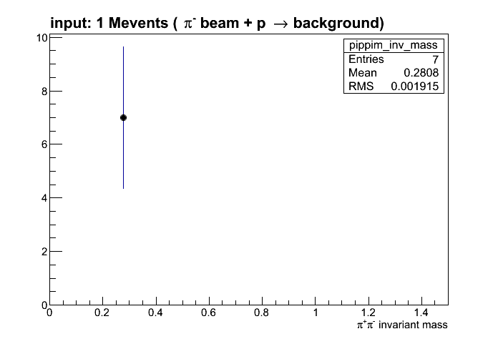
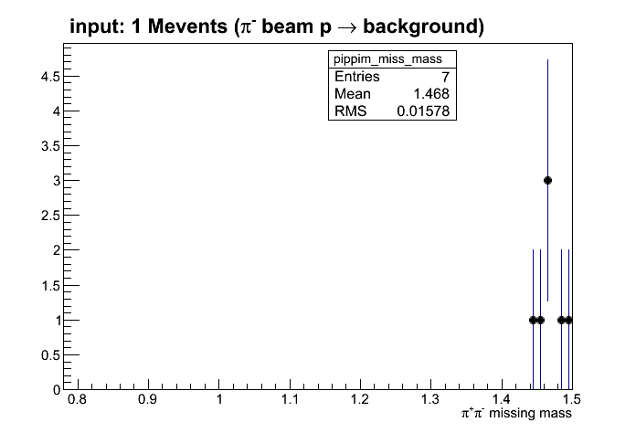
Background simulation
7 events reconstructed ☺ from 1 Mevents background

