Slide 1
Background from pion beam interactions with LH2 & solid state targets
J.Biernat/I.Koenig/J. Markert/W.Przygoda/P.Salabura

Slide 2
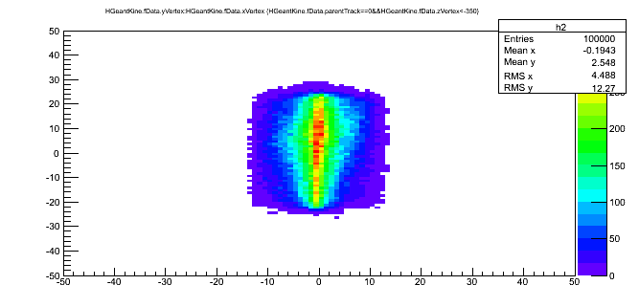
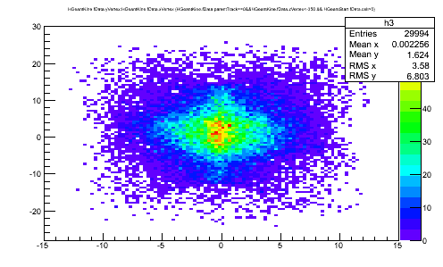
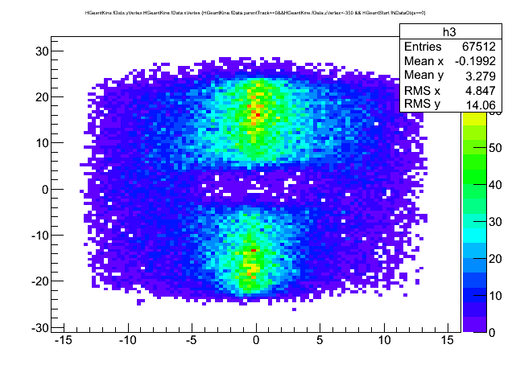
Distribution of Pions at emission plane located -1.3 m upstream-LH₂ target
Acceptance of beam line selects pions with Δp/p
σ = 1.8%
Narrow in x and rather broad in Y with slight assymetry up-down
Primary Pions which made
START hit (~30%)
Primary Pions which did not make START hit

Slide 3
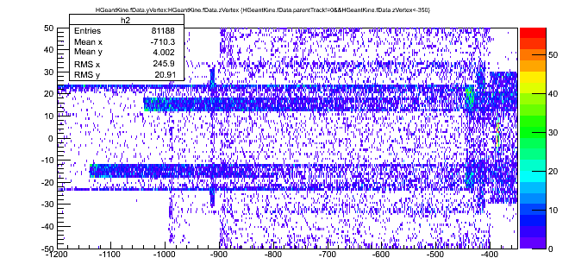
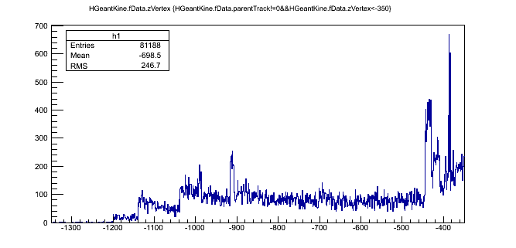
Vertex of secondary particle production (Y,Z)-LH₂ target
START
Z vs Y distribution:
Pions (100k) emitted from -1.3 m; 80k secondaries
START detector located at -0.38 m (-380 mm )

Slide 4
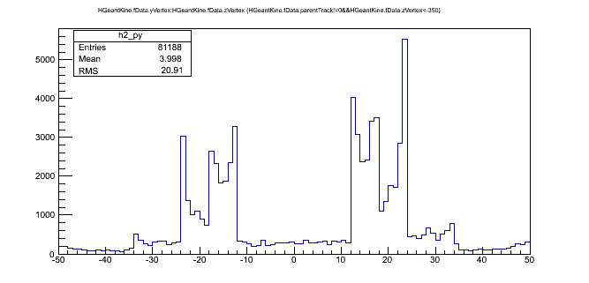
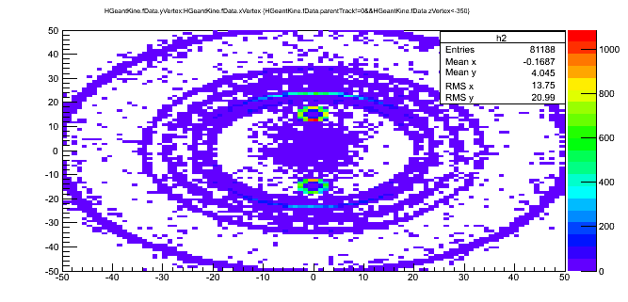
Vertex of secondary particle production (X,Y)-LH₂ target pipes
Y distribution:
Pipes with LH2 visible inside 20 mm diameter
-22,22 mm – tube
X vs Y distribution:
LH2 pipes and tube are clearly visible

Slide 5
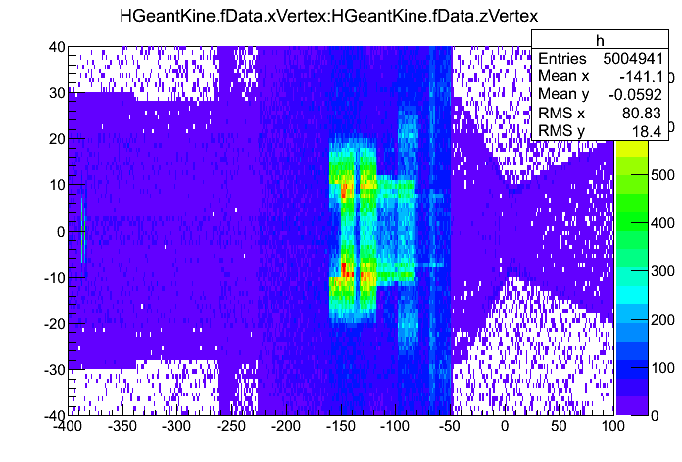
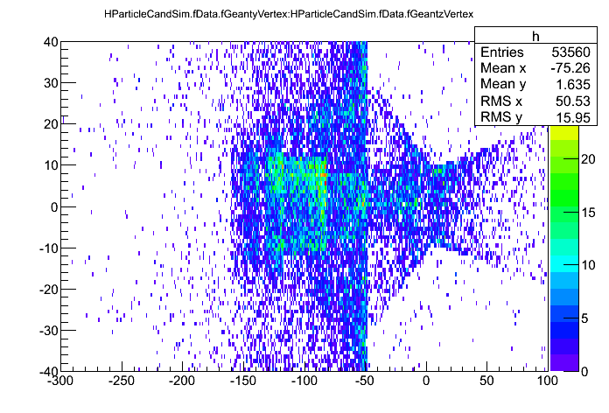
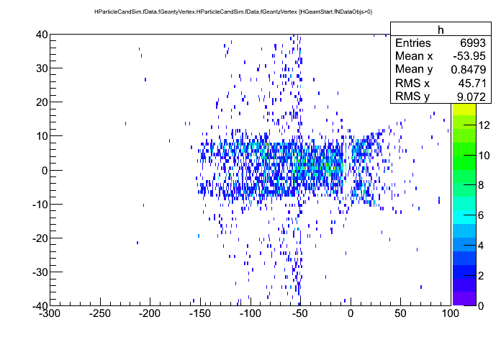
Vertex of secondary particle production (Y,Z)-LH₂ target region
Vertex (z,X) of all secondaries -geant
Vertex (Y,z) of all secondaries - reconstructed by tracking
Vertex of all secondaries - reconstructed by tracking and with hit in START
1 Mln pions emitted from 1.3 m –upstream the target

Slide 6
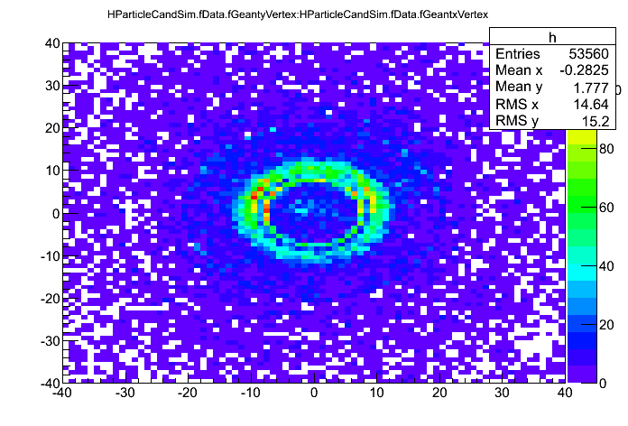
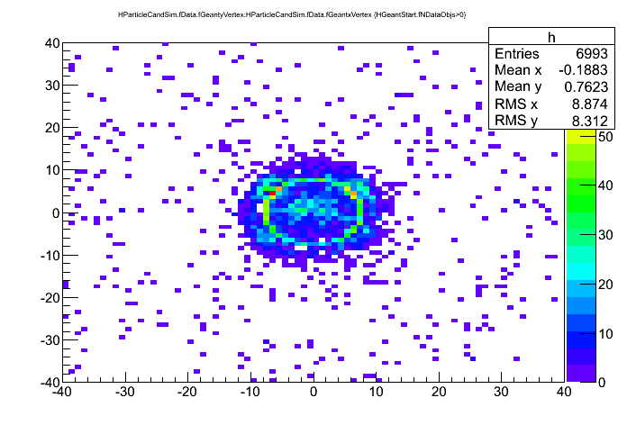
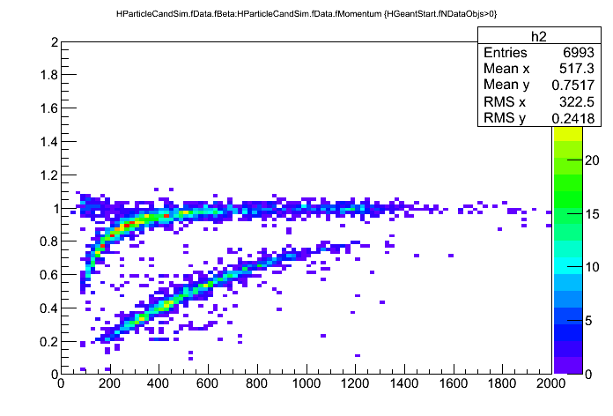
Vertex of secondary particle production (X,Y)-LH₂ target region
X,Y vertex –
all reconstructed by
Tracking (left)
(right) same BUT with hit on START
- still some background from target frames visible
PID plot for reactions triggered by pions with START hit
0.7% from ALL (1MLN) emitted pions
2.1% from pions making START hit

Slide 7
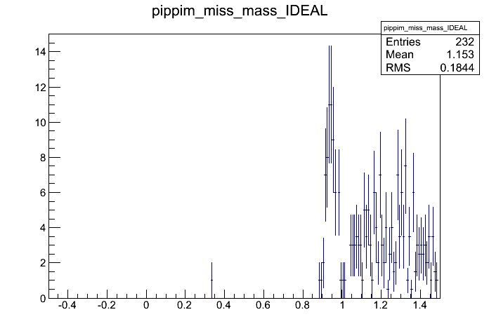
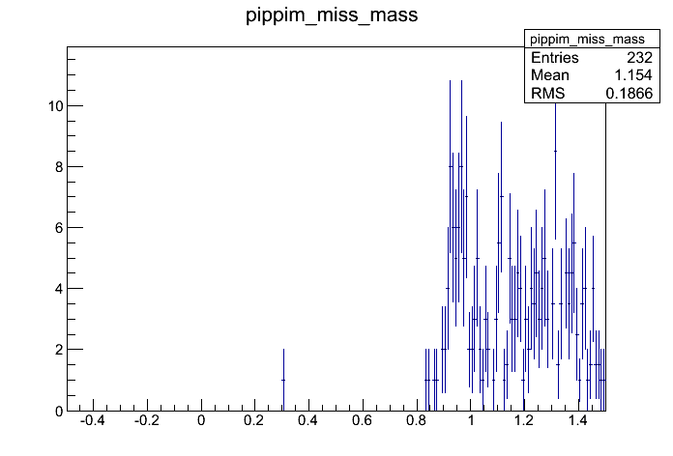
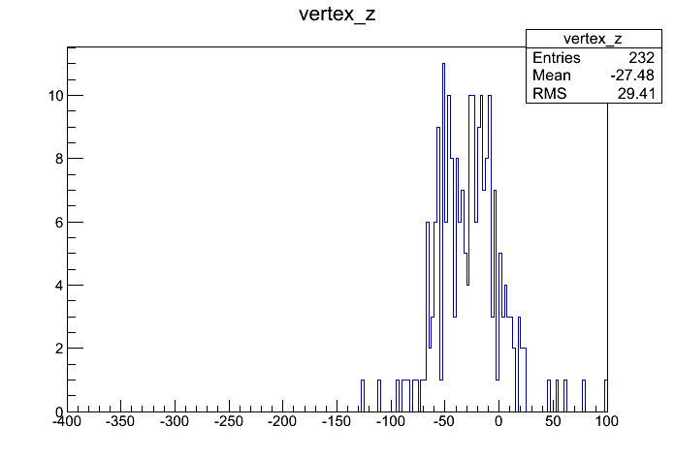
π⁺ π⁻ reconstruction from pion beam interactions
π⁻ p reactions
π⁻ A reactions
HADES resolution: smearing due to beam momentum smearing (~1.5% σ )
No HADES resolution: mmentum smearing due to beam momentum smearing (~1.5% σ )
~50 counts from π⁻ p reactions for 1 MLN (~30% on target)
Expected : 2*10²³ (atoms LH2) * 3*10⁵ * 16[mb]* 10⁻²⁷ (XS)*0.07-0.2 (reco*acc)= 58-150
Remark: reco*acc depends on model : PHSP ~ 0.2/ Bonn-Gat-0.065

Slide 8
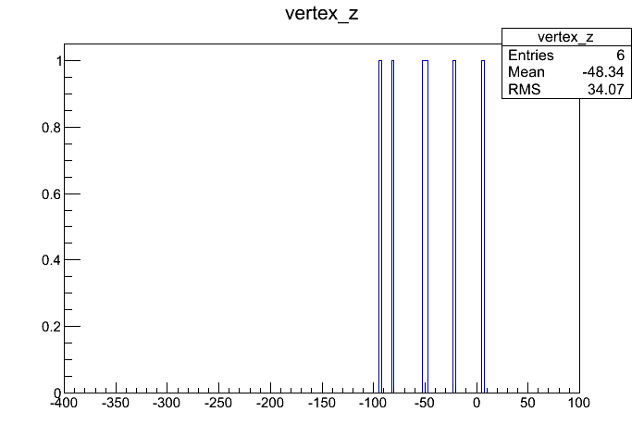
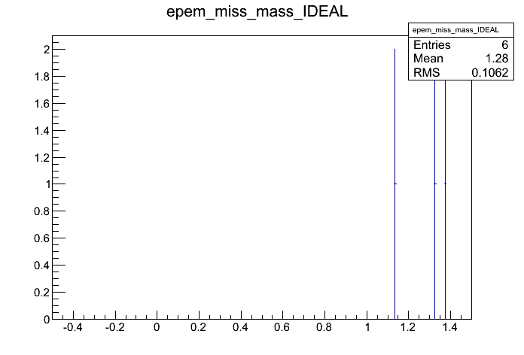
e⁺ e⁻ reconstruction from pion beam interactions
Reconstructed from 1MLN events

Slide 9
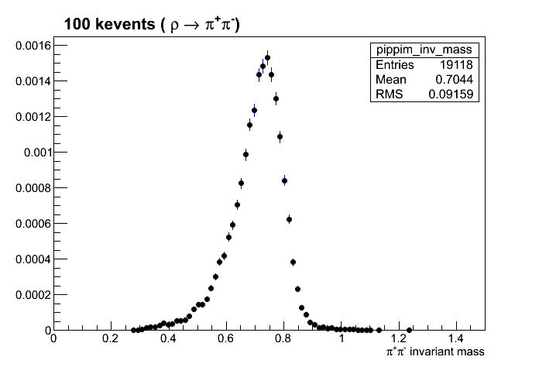
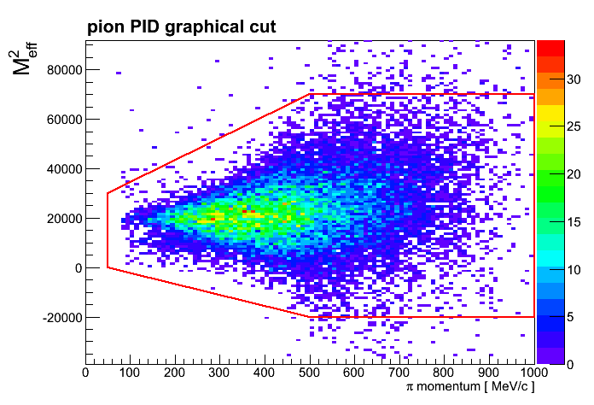
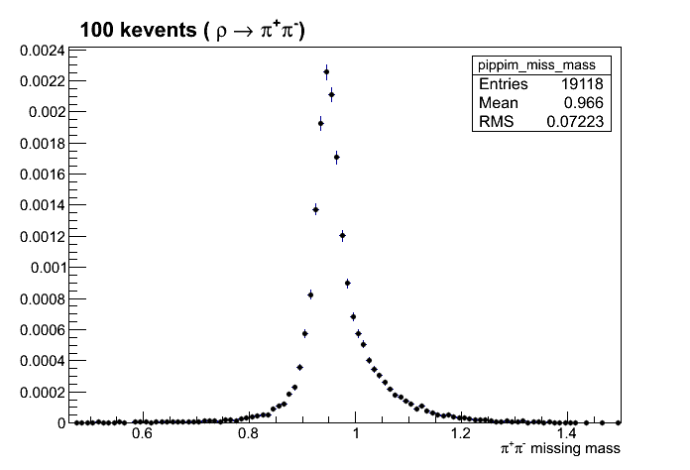
Benchmark channel π⁻p→ρn→π⁺ π⁻ n
GRAPHICAL pion PID CUT on physics channel
Invariant mass (left) total acc*reco=20%
Missing mass (left)

Slide 10
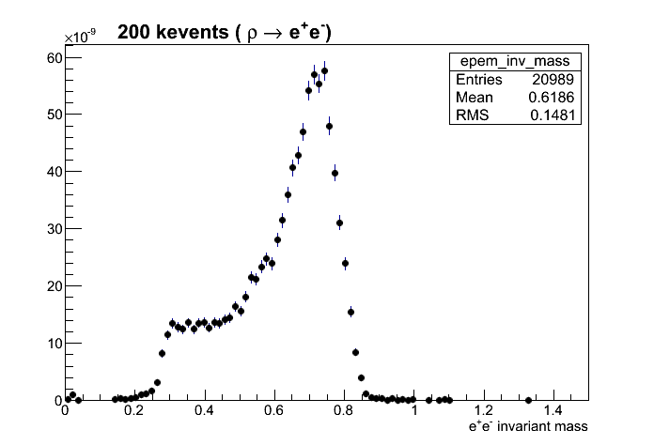
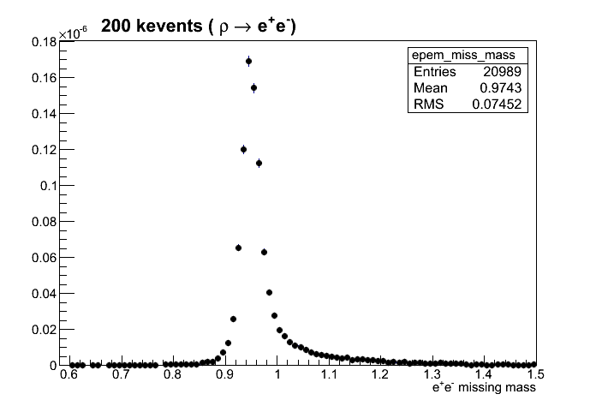
Dilepton channel π⁻p→ρn→e⁺e⁻ n
About 21 kevents reconstructed from 200 kevents (phase space)- reco*acc= 10% 0.5 reduction as compared to 2pion analysis

Slide 11
Nuclear targets

Slide 12
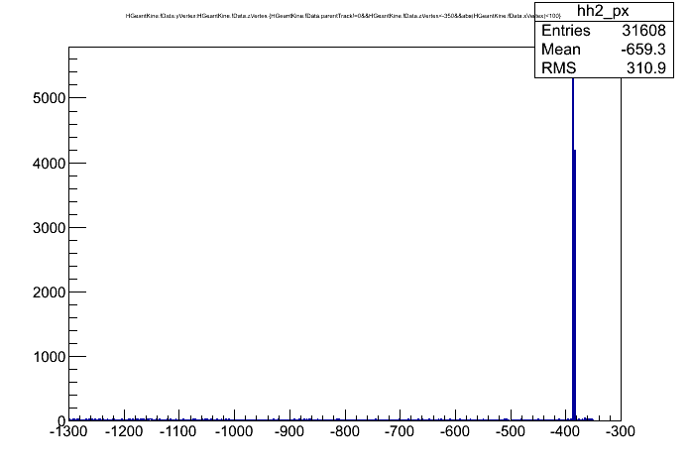
Nuclear targets: background from beam-pipe interactions
Secondary production before START (at -380 mm START detector visible)
(1 MLN pions emitted)

Slide 13
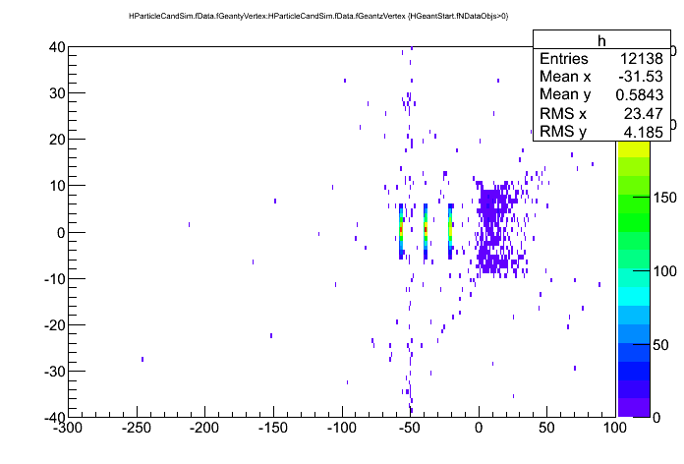
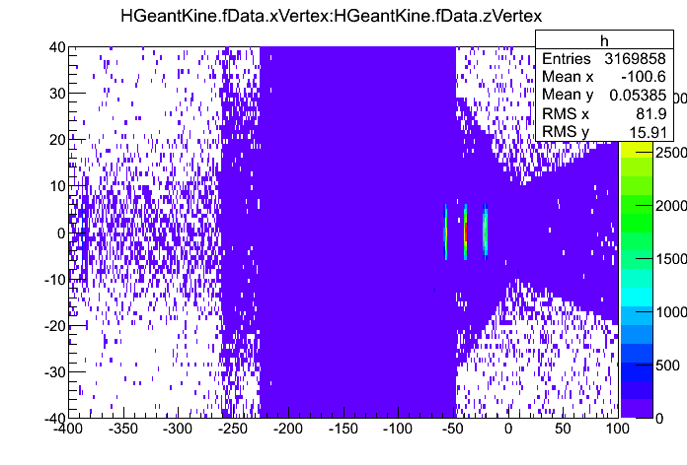
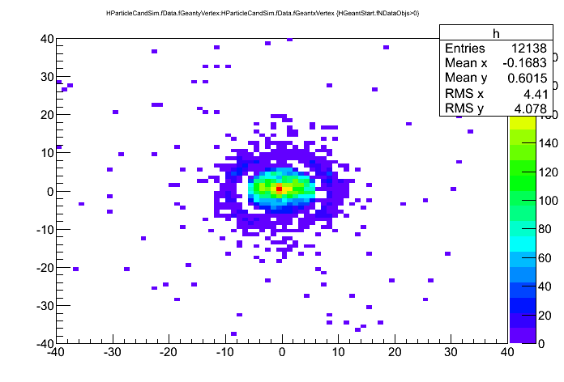
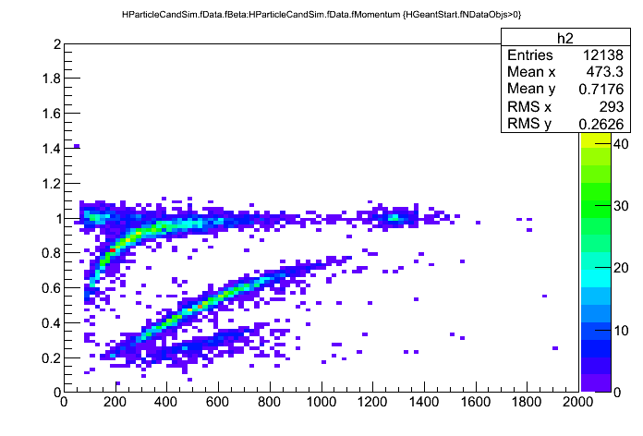
Pion interactions with Tungsten target (d=2.4mm-2.0%)
Reconstrcuted by tracking from reactions with START hit
Geant Vertex –all particles –
target region
1MLN pions emitted
x,y distributions :
reconstructed by tracking from
Rections with START hit
~3% interactions makes track in HADES

Slide 14

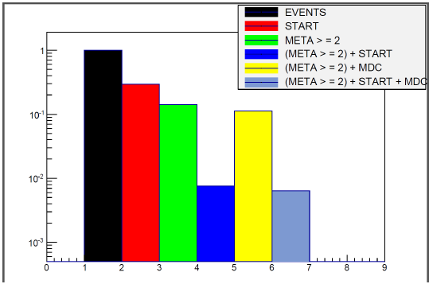
Hit rates for different conditions and targets
Tungsten (emission plane at -1300)
LH2 geometry
Trigger (META>=2 & START) suppression ~10⁻² for both set-ups. Assuming 5*10⁵ pion/s coming out at -1.3m it gives ~5 kHz rate
Rate in META larger in LH2 case by factor 3-4

Slide 15
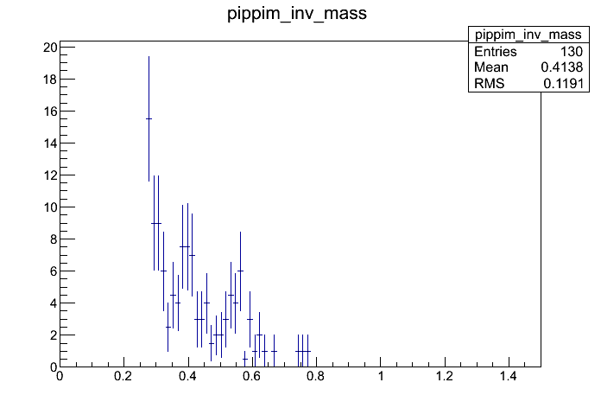
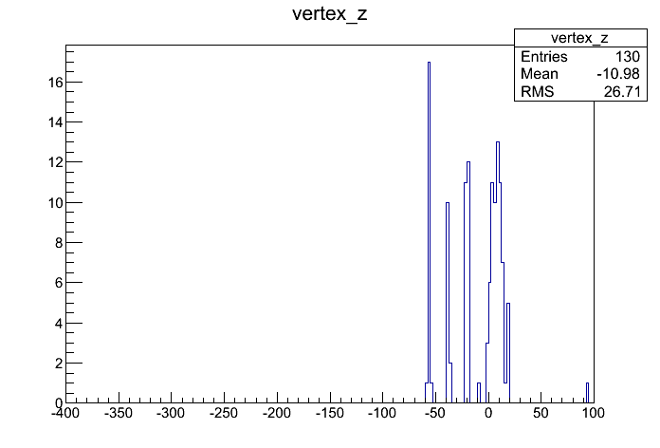
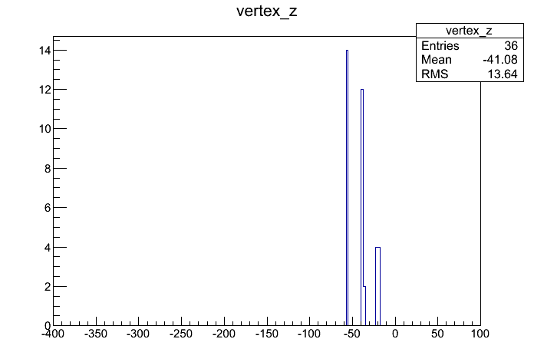
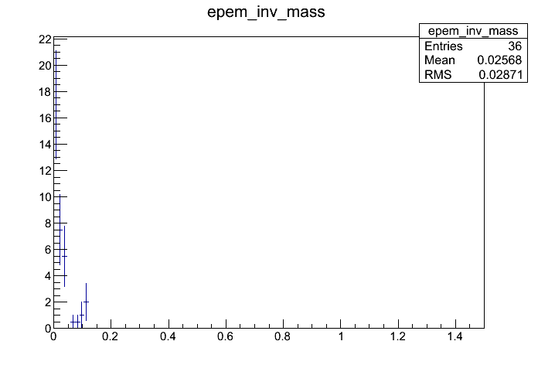
π⁺ π⁻ /e⁺e⁻ reconstruction from pion beam interactions
Geant vertex of reconstructed track

Slide 16
Strangeness production from GiBUU
p=1.7 GeV/c

Slide 17
Physics cases for dileptons: predictions from models

Slide 18
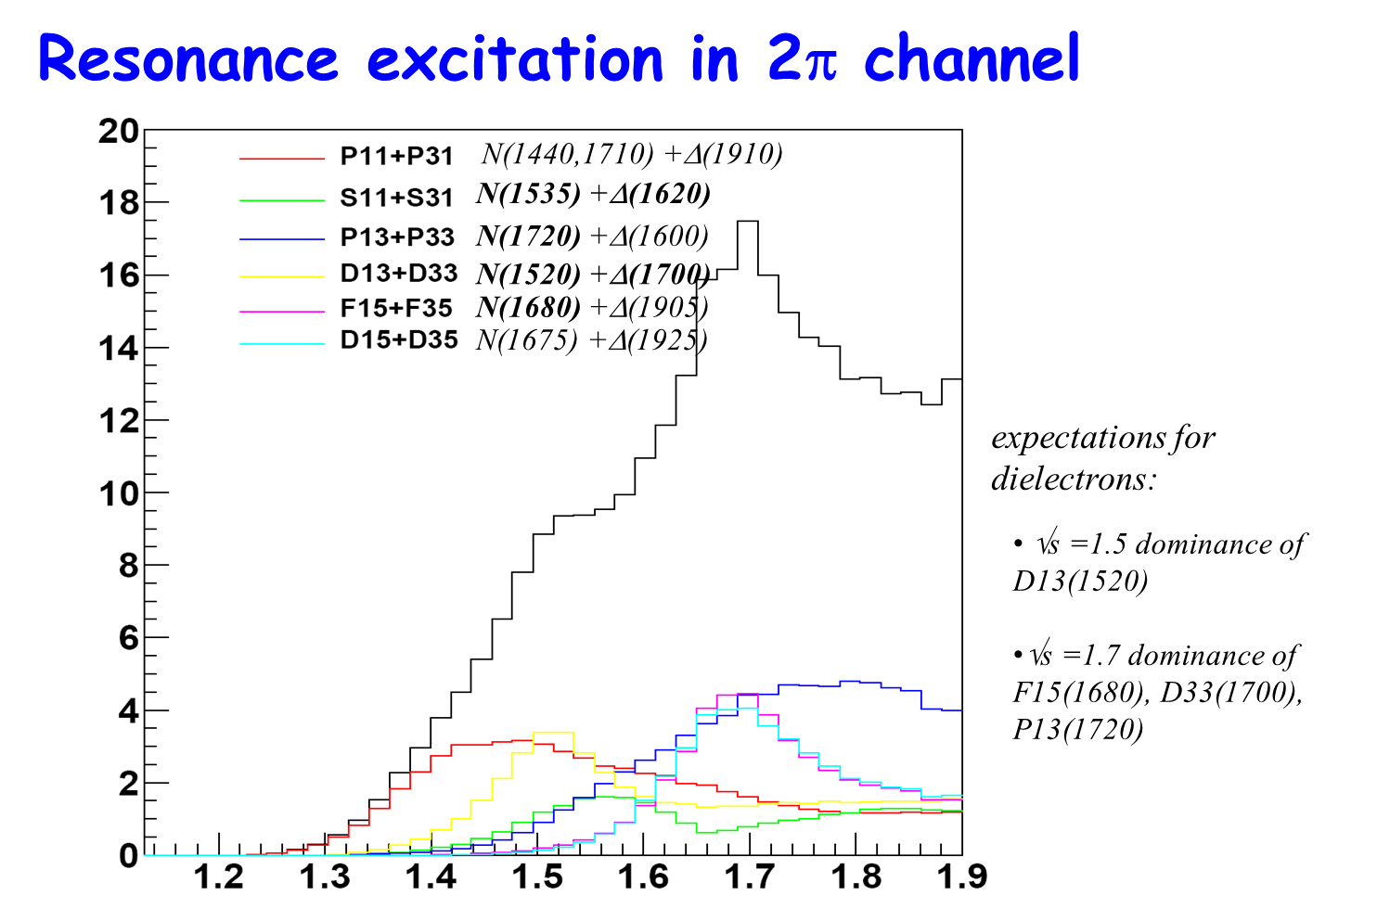
A.Sarantsev (Bonn-Gatchina)
notation: P (orbital momentum ; l=1)
1 - total I (2*I)
1 - total J (2*I)

Slide 19
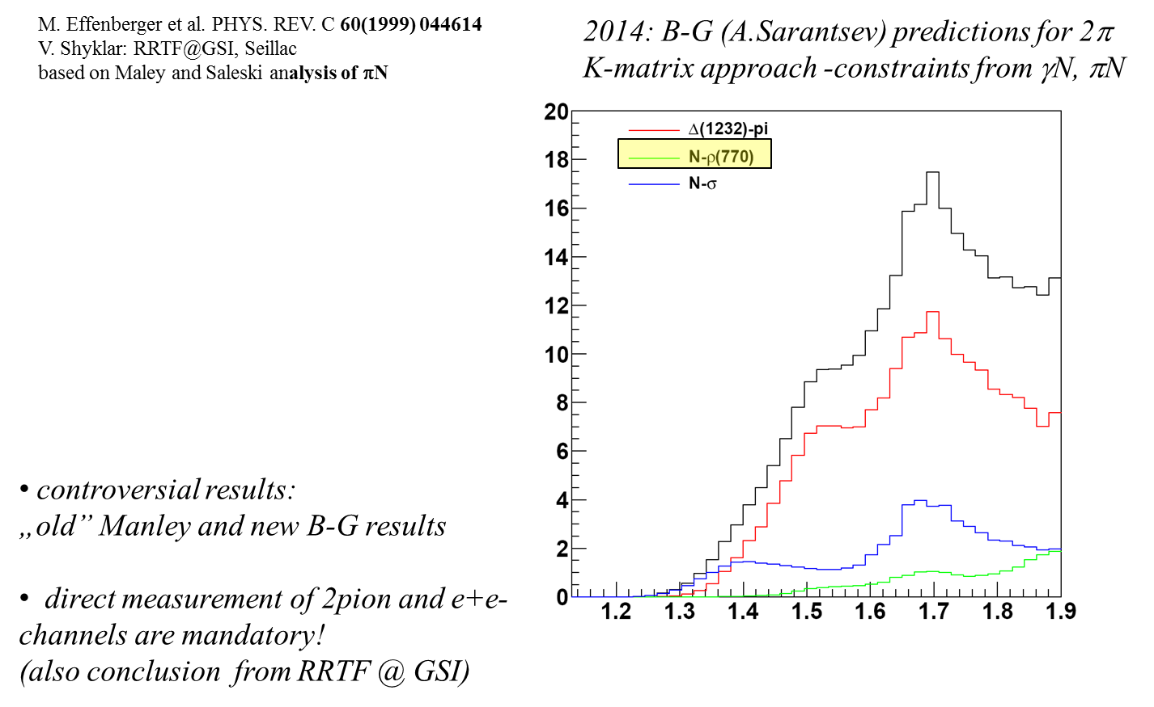
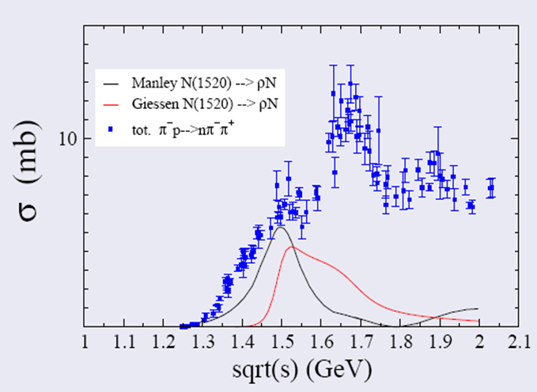
Very different predictons (factor 10!) for subthreshold ρ production

Slide 20
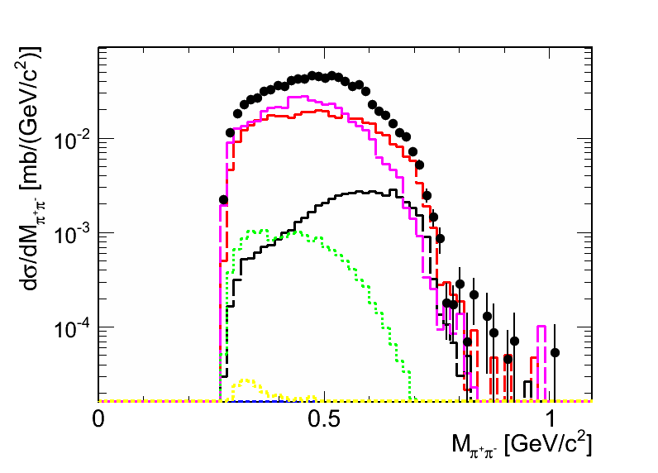
Events from A.Sarantsev (Bonn-Gatchina): π⁺ π⁻ √s=1.7 GeV
In HADES acceptance
red (Δπ),
black (ρ N),
magenta (σ N),
green (N1520, π) (N(1520)-πN)
żółty (N1680, π ).
black dots - "total".
Integrated cross section (4π)
Total : 16.0 mb
(ρ N): 0.78 mb
Inside HADES acceptance reconstructed:
Total: 0.91 mb
(ρ N): 0.05 mb (average recon*acc=6.5%)
Remark: yield in histogram is NOT divided by bin size: cross section can be obtained by sum of channels

Slide 21
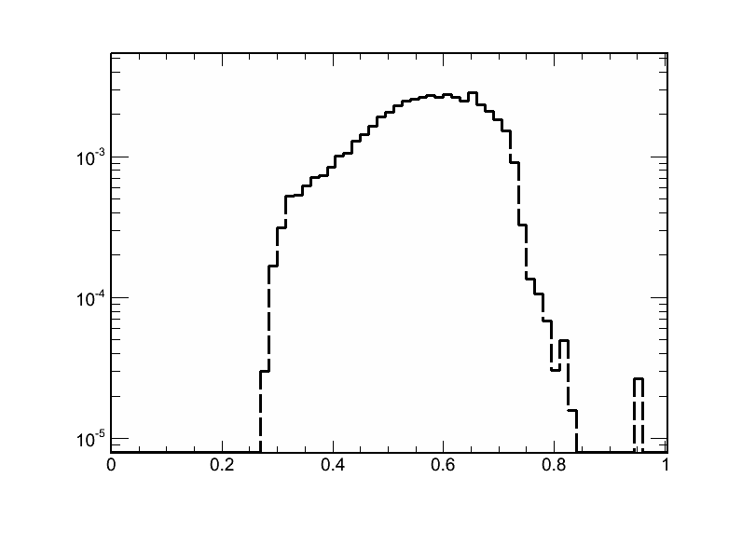
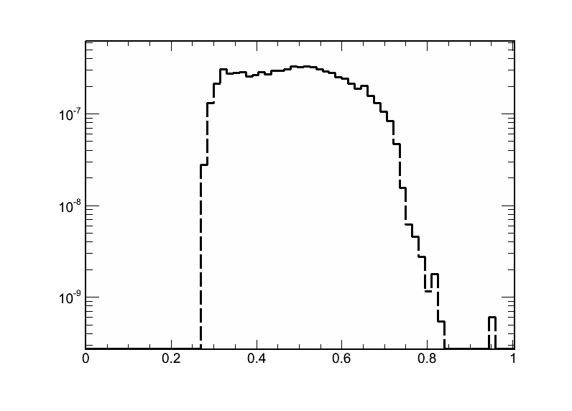
Reconstructed in HADES cross sections - ρ component
2 pion cross section vs inv. Mass 2π
dielectron cross section vs inv. Mass e+e-
Remark: yield in histogram is NOT divided by bin size (~0.01 GeV)
Integrated e+e- cross section (M>0.28 GeV/c) 7.3 nb (acceptance), 110 nb(full solid angle)
Remarks; 4.7*e-5 (BR)*0.05mb= 2.35 nb ; 7.3 nb is higher due to 1/M³ factor (gives an everage enhancement factor 3.1)
RICH efficiency not included in above estimation ~ reduction factor 0.5
Integrated cross section 0.05 mb

Slide 22
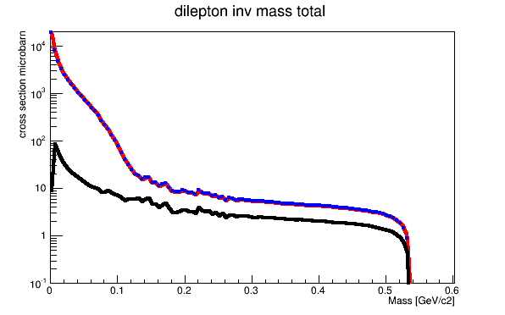
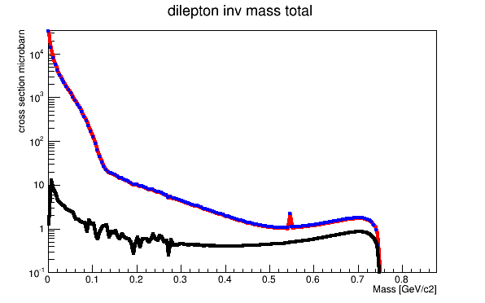
Predictions from GiBUU: J.Weil’2014
E_{π} = 540 MeV (p=0.66 GeV/c) √s=1.5 GeV
E_{π} = 900 MeV (p=1.03 GeV/c) √s=1.7 GeV
Total
ρ component
Integrated cross section for M>0.28 GeV/c² (full solid angle) 484 nb
(~ 8 higher than in B-G model)
Integrated cross section for M>0.28 GeV/c² (full solid angle) 247 nb
(~ 2.5 higher than in B-G)

Slide 23
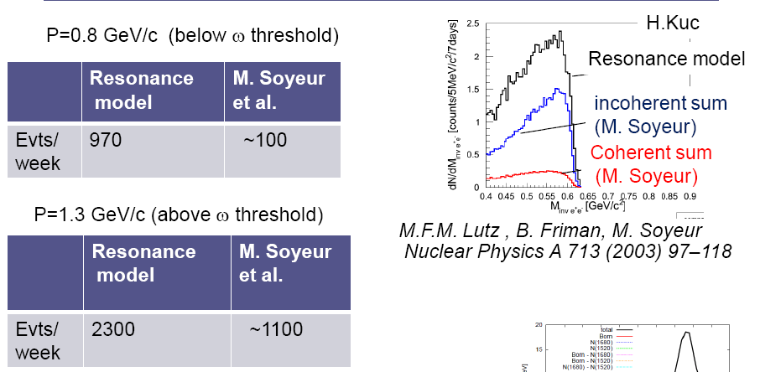
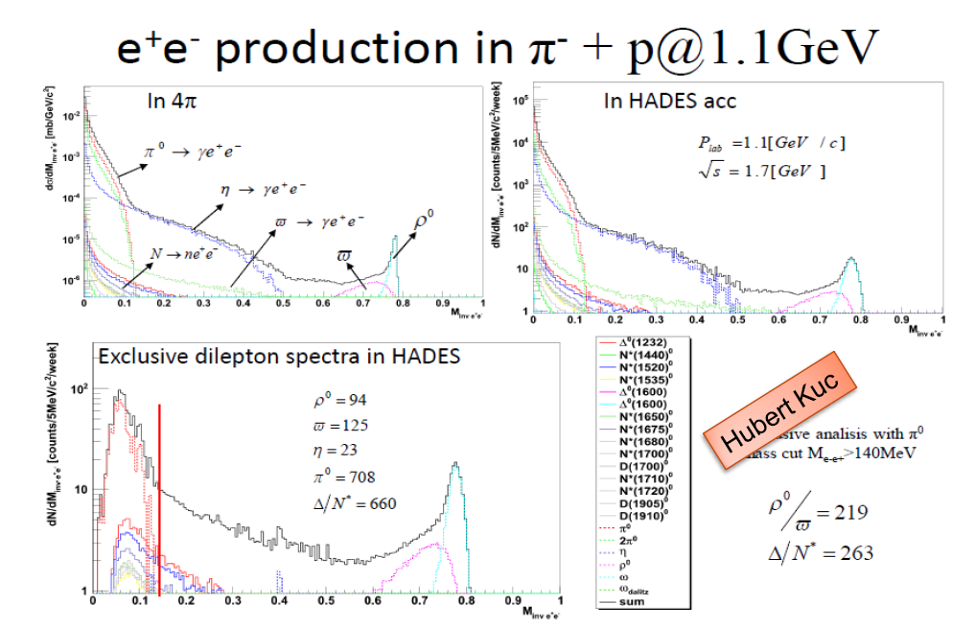
Estimates (e+e- M>140 MeV/c²)-TDR
p =1.1 GeV/c
Resonance model: constant eTFF (QED)from Zetenyi & Wolf

Slide 24
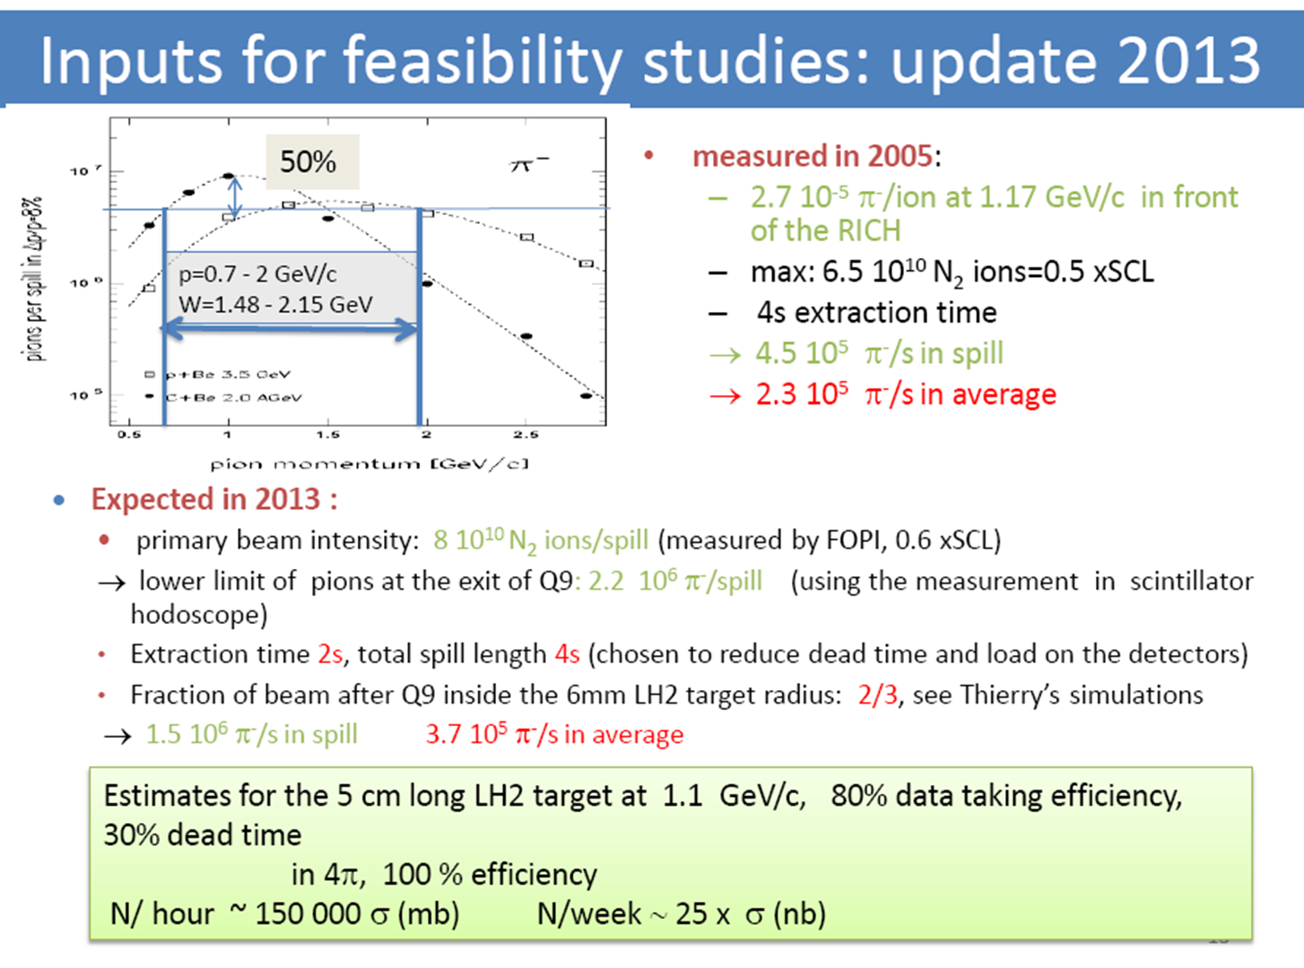

Slide 25
Count rate estimates
Assuming beam intenisties from previous slide and acc *rec from SIM
 | LH2 case [counts/24h] p [GeV/c] beam momentum | Solid targey (tungsten) case [counts/24h] p [GeV/c] beam momentum
Dilepton yield M>0.3 GeV („Manley-transport model” scenario)-ρ contribution | p=0.66 ~50 P=1.03 ~25 | ~ 150 ~ 75
Dilepton yield M>0.3 GeV (Bonn_Gatchina)- ρ contribut. | p=0.66 ~ 7 * similar to Soyer/Lutz) p= 1.03 ~12 | ~ 21 ~ 36
Two-pions (π+π- ) | p=1.03 ~3e6
Σ⁻ K⁺ | p=1.03 ~96 000
Λ K⁰ | p=1.03 ~26 000
Σ⁻ K⁺ | p=1.03 ~20 000
σ ~ σ_{πN} A^{2/3} scaling assumed
See slide 16 for strangeness on nucleus production

