Slide 1
Latest news from LH2: picture and dimensions taken on 13/6/13
T. Hennino
R. Skowron
IPN Orsay

Slide 2
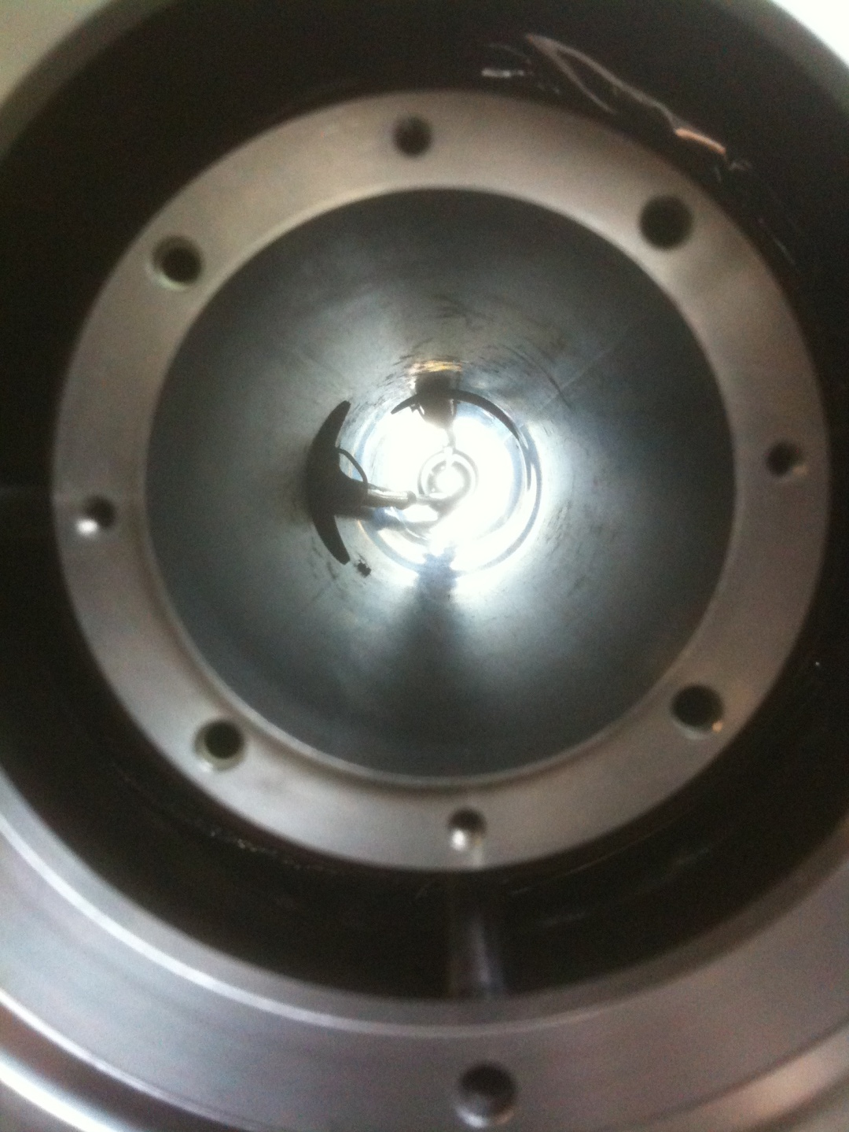
Front view of target seen from accelerator side
The 2 pipes to feed the liquid target vessel are seen clearly
One comes from the top ( ϕ = 90°) and goes until the target at the same ϕ = 90°
The other one starts at ϕ = 0° and goes progerssively to the lower part of the target (ϕ = 270° )
The entrance diameter is 46 mm
The available diameter within the pipes is of the order of 22 to 22 mm (difficult to measure accurately)
75 mm
46 mm

Slide 3
Maybe a better view on how the tubes are located inside the 46 mm cylinder
The ‘gold’ ring has a radius of about 5 mm.
The outer part of the ring is just a reflexion on the cylinder surface. One clearly see the entrance Mylar window of the target.
Available diameter within the pipes ≈
20-22 mm !!

Slide 4
Target end point
Target center
74 mm
15 mm
305 mm
495 mm
22 mm
Max position of diamond detector
Minimal distance between target center and diamond ≈ 382 mm

Slide 5
Front view of liquid vessel seen from beam dump side.
The entrance Mylar window
(diameter ≈ 15 mm)
the exit Mylar window
( diameter ≈ 30 mm)
The superinsulation

Slide 6
Front view of liquid vessel seen from beam dump side.
the exit Mylar window
( diameter ≈ 30 mm)
The superinsulation

