Slide 1
Beam transport: Checks in PLUTO

Slide 2
Element positions along the beam line
This excell table gives positions in mm going from target backward

Slide 3
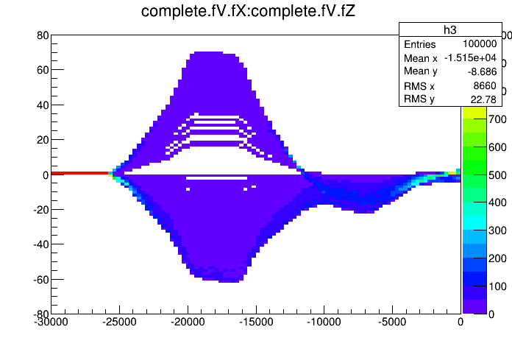
Effect of Dp/p =+-8%
//Init the reaction for c.m. sampling:
PBeamLineSimulation *sim = new PBeamLineSimulation("beam", "Beam line simulation");
sim->SetReaction("p + p");
//Read the data file
sim->InitBeamLine("pibeam_set6.data");
//Place (virtual) detector along the beam line. Units are in mm:
sim->AddDetector("det1", -3000.0);
sim->AddDetector("det2", -6000.0);
for (double dist = -30000; dist<0; dist+=300)
sim->AddDetector("complete", dist);
//open the ROOT file and type:
//data.Draw("complete.fV.fX:complete.fV.fZ >>h3(100,-30000,0,100,-80,80)","","colz");
//Choose which module should be the target:
sim->TargetIsElement(33);
//Select the global momentum:
sim->SetGlobalMomentum(3.0);
//Beam profile at the production target
//position in mm:
sim->Do("_beam_x = 0; _beam_y = 0;");
//divergence in px/pz and py/pz:
//sim->Do("_beam_px = 0; _beam_py = 0.05;");
sim->Do("_beam_px = 0; _beam_py = 0;");
//momentum spread:
sim->Do("_beam_dp = 0.16*sampleFlat() - 0.08; "); //+- 8%
//sim->Do("_beam_dp = -0.08; ");
//Add and enable module:
makeDistributionManager()->Add(sim);
PReaction my_reaction("_T1 = 2.2","p","p","p p eta [dilepton [e+ e-] g]", "beam_line");
//PReaction my_reaction("_T1 = 2.2","p","p","p p", "beam_line");
my_reaction.Print(); //The "Print()" statement is optional
my_reaction.Loop(1000);
units in Z and X are in mm

Slide 4
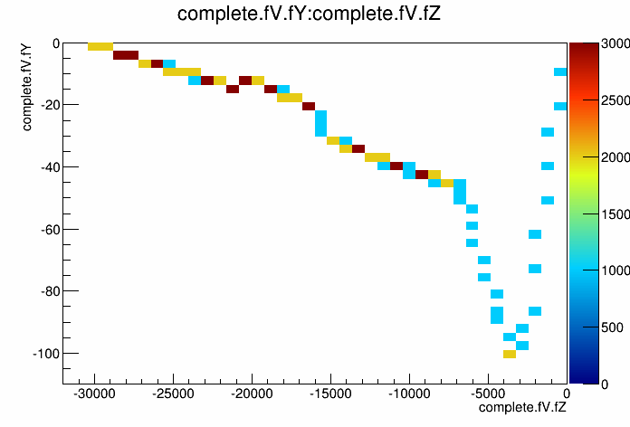
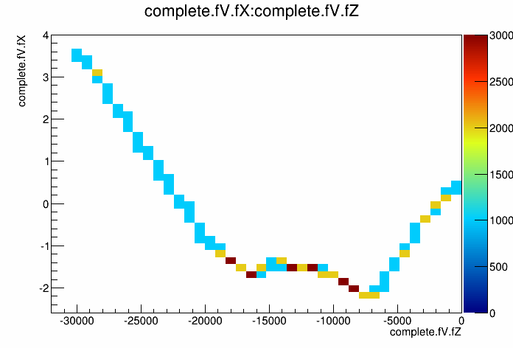
Pion production point: X:1mm, Y:1 mm
//Beam profile at the production target //position in mm:
sim->Do("_beam_x = 1.; _beam_y = 1. ;
//divergence in px/pz and py/pz:
//sim->Do("_beam_px = 0; _beam_py = 0.05;");
sim->Do("_beam_px = 0; _beam_py = 0;");
//momentum spread:
//sim->Do("_beam_dp = 0.16*sampleFlat() - 0.08; "); //+- 8% sim->Do("_beam_dp = 0.00;

Slide 5
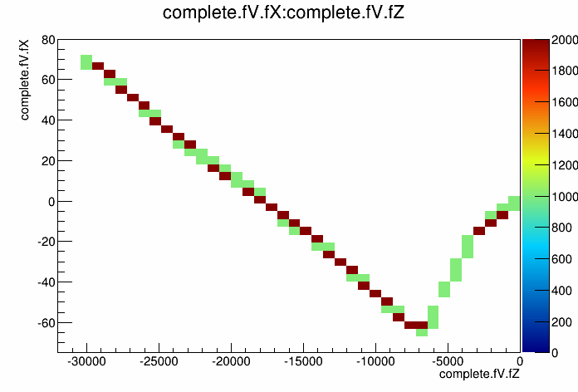
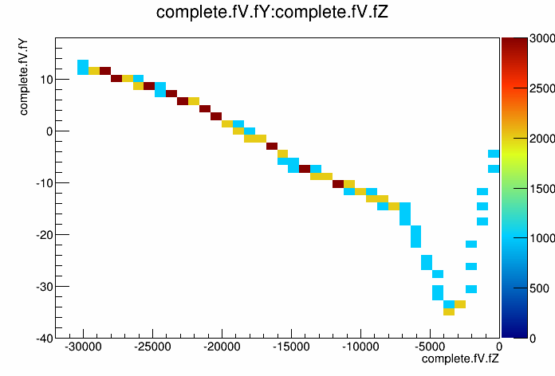
Pion emission angles: ΔΘ=10, Δφ=20 mrad
//Beam profile at the production target //position in mm:
sim->Do("_beam_x = 0..; _beam_y = 0. ;
//divergence in px/pz and py/pz:
//sim->Do("_beam_px = 0; _beam_py = 0.05;");
sim->Do("_beam_px = 10; _beam_py = 20;"); // mrad !!
//momentum spread:
//sim->Do("_beam_dp = 0.16*sampleFlat() - 0.08; "); //+- 8% sim->Do("_beam_dp = 0.00;

Slide 6
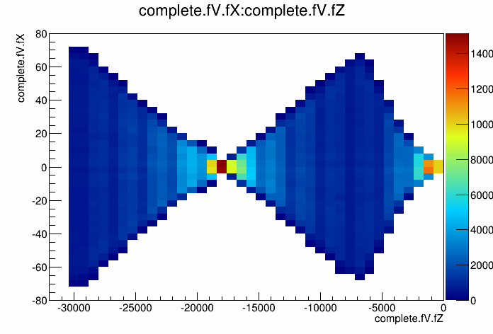
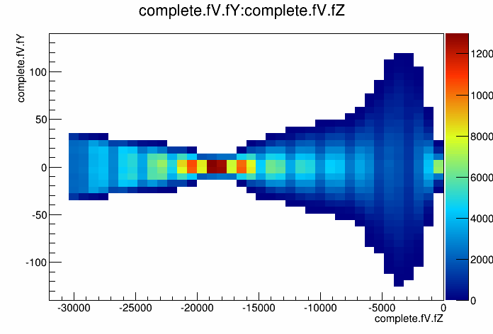
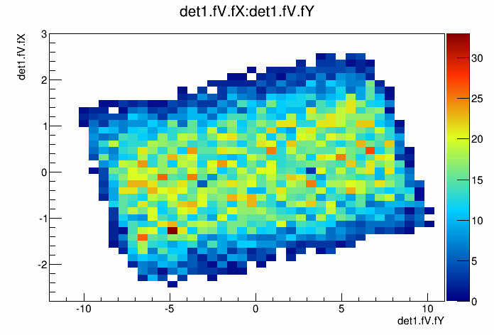
Dp=0.0, Full smearing ΔΘ,φ and ΔX₀Y₀

Slide 7
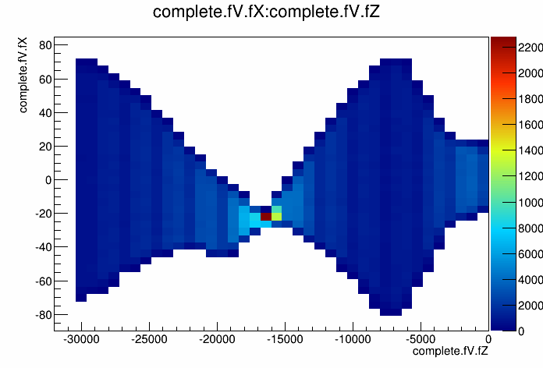
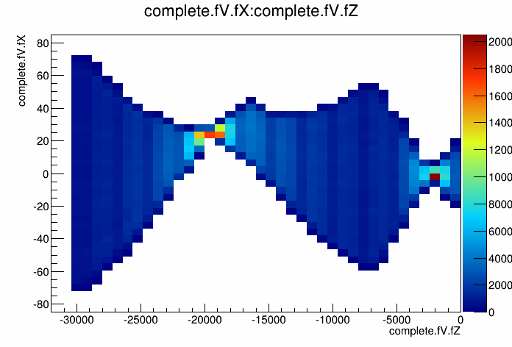
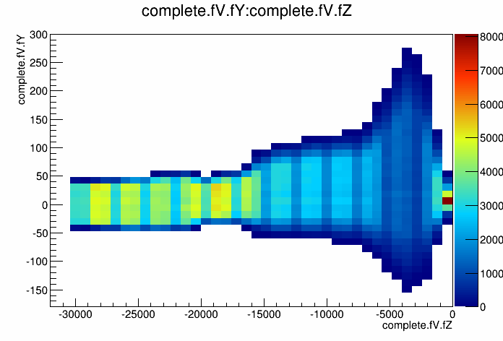
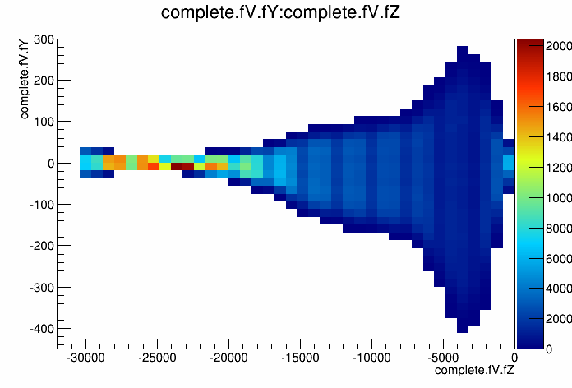
Dp=±3%, Full smearing ΔΘ,φ and ΔX₀Y₀
+3%
-3%

Slide 8
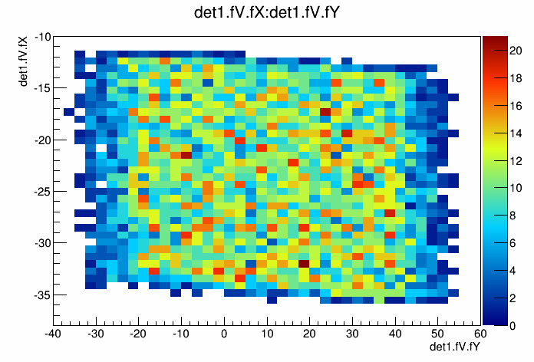
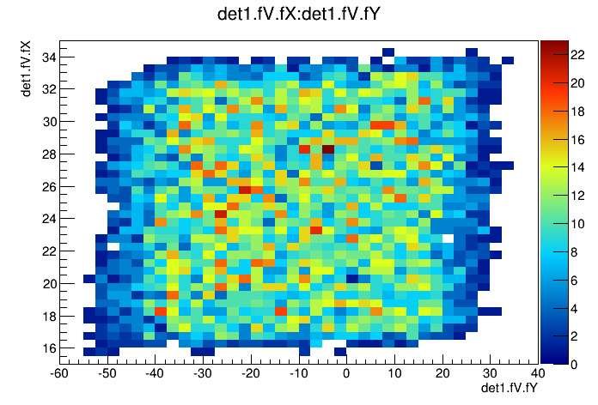
Dp=0%,±3%, Full smearing ΔΘ,φ and ΔX₀Y₀
+3%
0%
-3%

Slide 9
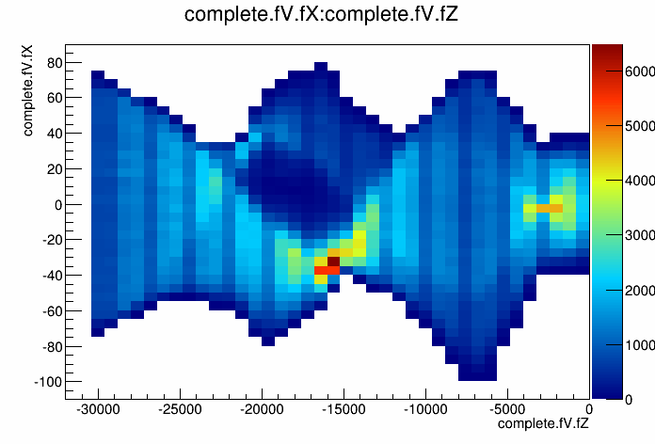
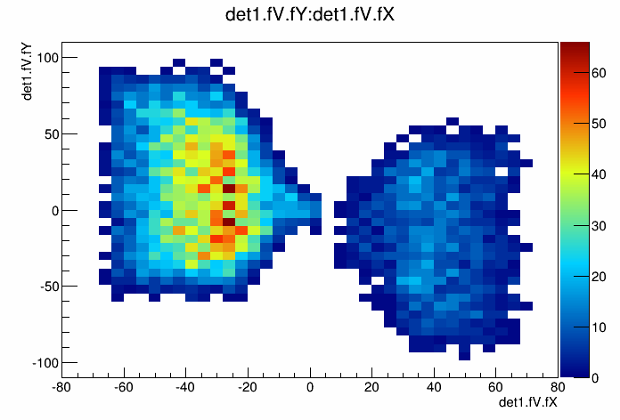
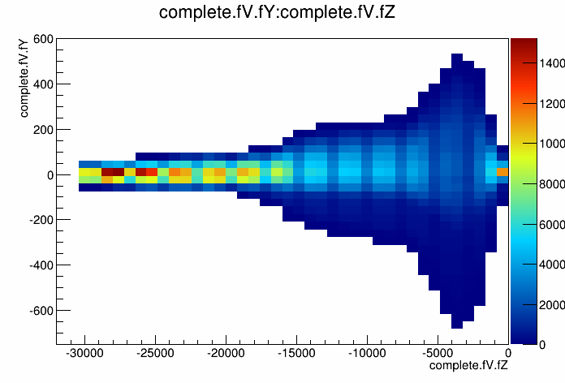
Full smearing Dp, ΔΘ,φ and ΔX₀Y₀
//Place (virtual) detector along the beam line. Units are in mm:
sim->AddDetector("det1", -18092.6);
sim->AddDetector("det2", -6310.0);
for (double dist = -30000; dist<0; dist+=300)
sim->AddDetector("complete", dist);
//Choose which module should be the target:
sim->TargetIsElement(33);
//Select the global momentum:
sim->SetGlobalMomentum(3.0);
//Beam profile at the production target //position in mm:
sim->Do("_beam_x = 1.*sampleFlat()-0.5; _beam_y = 1.0*sampleFlat()-0.5;"); //+- 1mm //divergence in px/pz and py/pz:
sim->Do("_beam_px = 20.*sampleFlat()-10.; _beam_py = 100.*sampleFlat()-50.;");
//momentum spread:
sim->Do("_beam_dp = 0.12*sampleFlat() - 0.06; "); //+- 6%
something is wrong..

Slide 10
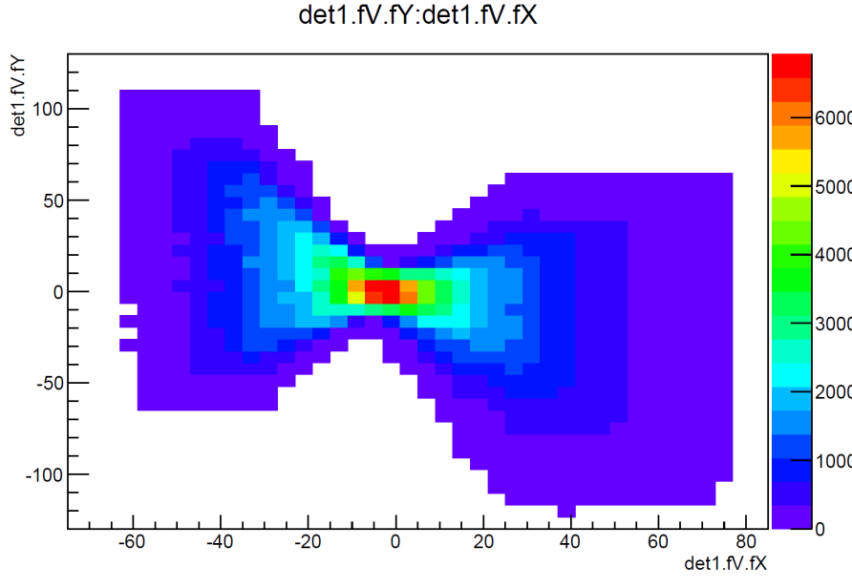
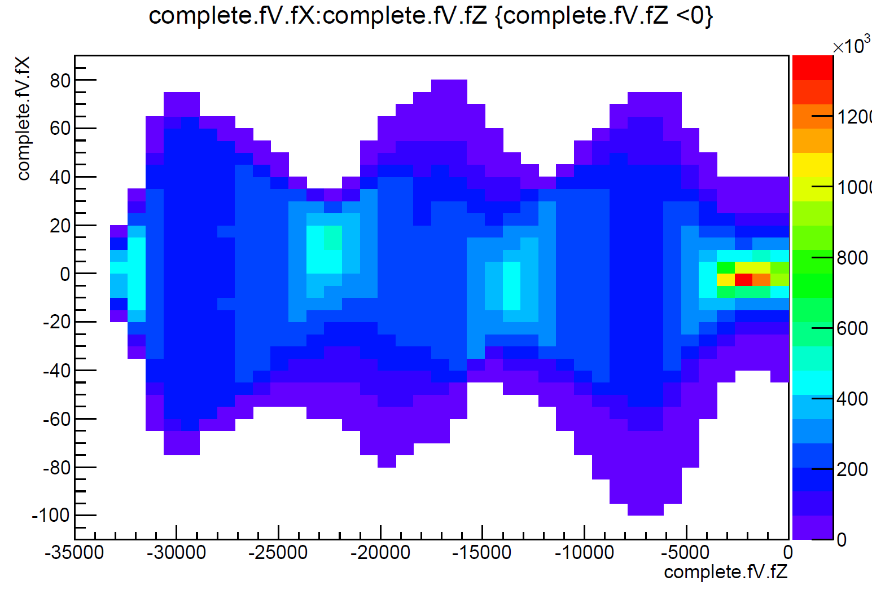
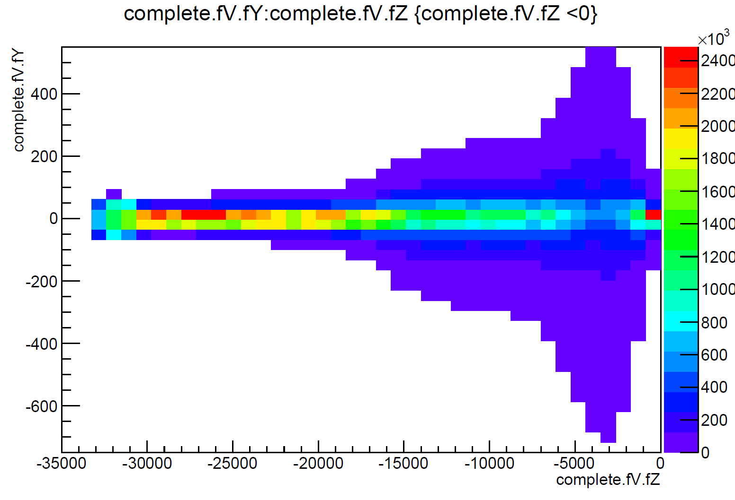
Full smearing Dp, ΔΘ,φ and ΔX₀Y₀
problem with momentum sampling found and removed
calculation of the output momentum from dp to p was not correct
Now all looks fine !

Slide 11
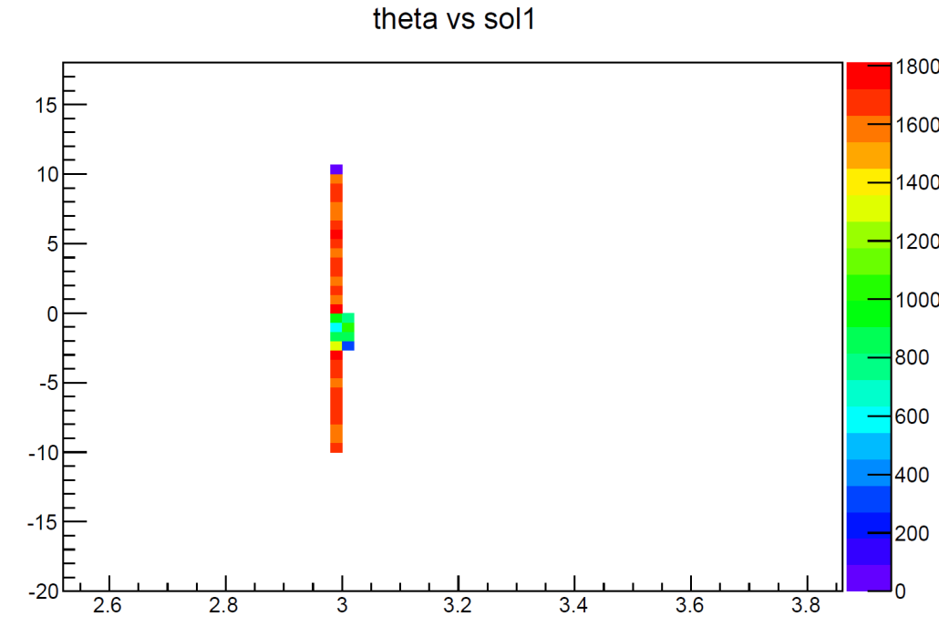
Test of mementum reconstruction
- delta(p)/p = 3 % emission angles ΔΘ uniform between -10 mrad and + 10 mrad i.e. px/pz -0.01 to 0.01 , no x and Y smearing
ΔΘ
Dp

Slide 12
New Simulation
{
//Init the reaction for c.m. sampling:
PBeamLineSimulation *sim = new PBeamLineSimulation("beam", "Beam line simulation");
sim->SetReaction("pi- + p");
//Read the data file
sim->InitBeamLine("pibeam_set6_mod.data");
//Place (virtual) detector along the beam line. Units are in mm:
sim->AddDetector("det1", -17092.6);
sim->AddDetector("det2", -5400.0);
sim->AddDetector("det3",-300);
sim->AddDetector("det4",-10);
for (double dist = -36000; dist<0; dist+=100)
sim->AddDetector("complete", dist);
//open the ROOT file and type:
//Choose which module should be the target:
sim->TargetIsElement(33);
//Select the global momentum:
sim->SetGlobalMomentum(3.0);
sim->Do("_beam_y = 1.0*sampleFlat()-0.5;"); //+- 1mm
sim->Do("_beam_x = 1.0*sampleFlat()-0.5;"); //+- 1mm
//divergence in px/pz and py/pz:
sim->Do("_beam_px = 0.02*PUtils::sampleFlat() - 0.01;");
sim->Do("_beam_py = 0.1*PUtils::sampleFlat() - 0.05;");
//momentum spread:
sim->Do("_beam_dp = 0.12*sampleFlat() - 0.06;"); //+- 6%
//Beam profile at the production target
//position in mm:
//Add and enable module:
makeDistributionManager()->Add(sim);
PReaction my_reaction("_T1 = 1.3","pi-","p","n w [e+ e-]","pi_p_n_rho0");
my_reaction.Print(); //The "Print()" statement is optional
my_reaction.Loop(500000);

Slide 13
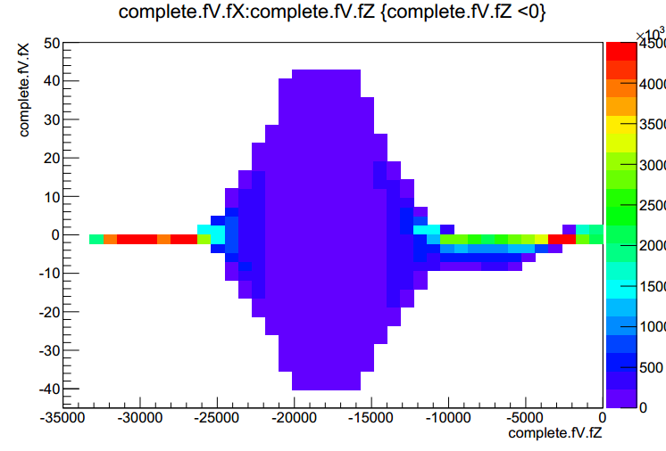
Results
Remark to syntax in PLUTO macro : settings of x, y /px ,py need to be set in separate lines
Results for beam profile are as expected

Slide 14
Momentum reconstruction at HADES target
A reconstruction of p_{x}, p_{y} ,p_{z} was preformed
To check the reconstructed values of momentum a so called target detector was implemented on the beam line simulation (1 cm before the target)
To simulate the acceptance of the beam line, a condition was introduced (x < 6 & y < 6)
A start detector was also added to the beam line (a hit from the start detector says that this was a valid event)
Simulated reaction: $π^{−}+p→n ω→n e^{+}{ e}^{−}$
Calculations of the mass of neutron was preformed for three situations (fixed momentum = 1.3, momentum form target detector, momentum coming from reconstruction)

Slide 15
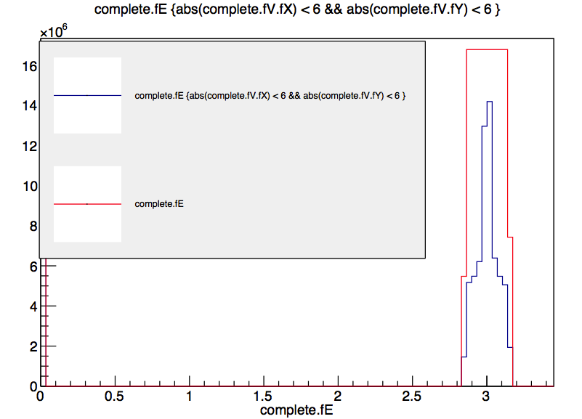
Acceptance cut

Slide 16
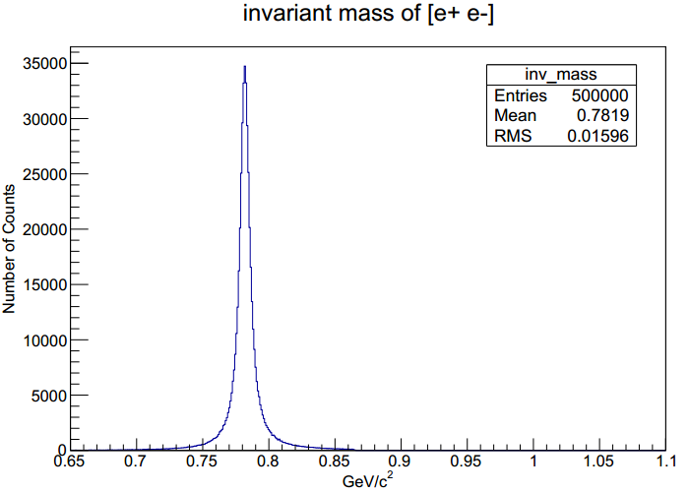
Results
Invariant mass of e+ e-

Slide 17
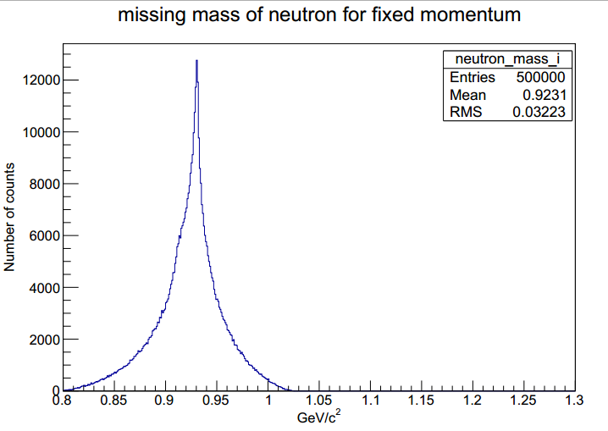
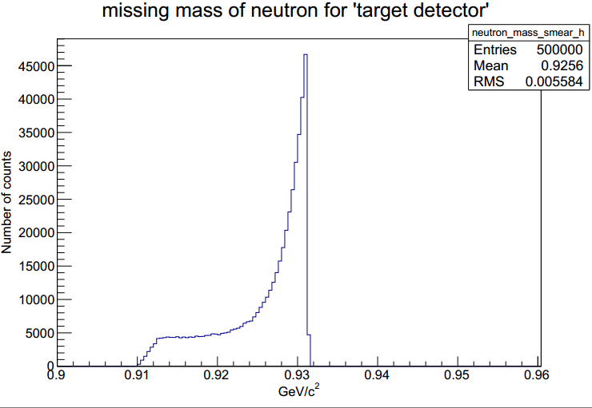
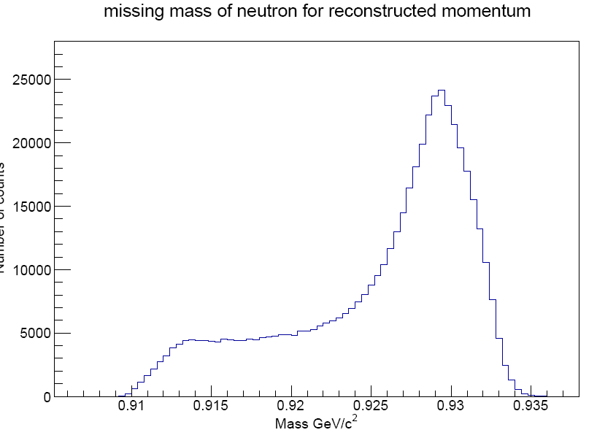
Neutron mass calculations
pion beam acceptance included
hits on start detector required (30 cm in front of the target 16x16 mm² active area)

Slide 18
Conclusions
The issue of missing momentum in the simulation is fixed;
Calculations of neutron missing mass show that the algorithm works as it should (same results coming from reconstruction and target detector)

